Slide 1
THIRD INTERNATIONAL CONFERENCE
ON ADVANCED CARDIAC SCIENCES
The Heart As King of Organs
PRINCE SULTAN CARDIAC CENTER
Al Ahsa, Saudi Arabia, September 27-30, 2010
Why Stress Is A Far More Important Cause
Of Coronary Disease Than Cholesterol
Paul J. Rosch, M.D., F.A.C.P.
President, The American Institute of Stress
Clinical Professor of Medicine and Psychiatry
New York Medical College
Honorary Vice President
International Stress Management Association

Slide 2
THE CHOLESTEROL - CHD HYPOTHESIS
Foods high in saturated fats and cholesterol (beef,
butter, eggs) significantly raise blood cholesterol.
Elevated blood cholesterol causes atherosclerosis that
blocks coronary blood flow, which eventually results
in a myocardial infarction.
Coronary heart disease can be markedly reduced in
healthy people by strictly avoiding saturated fat or by
administering cholesterol lowering drugs, particularly
statins.
NONE OF THESE CLAIMS ARE TRUE
Notes:
I have been asked to provide an update on my presentation at the last conference questioning the validity of the lipid hypothesis of coronary heart disease and why stress is far more important in its pathogenesis.
Since each of the above has been shown to be false, how did these myths originate? More importantly, why have they persisted?

Slide 3
CHOLESTEROL AND ATHEROSCLEROSIS
CHOLESTEROL - from the Greek chole (bile) and stereos (solid) since it was found in gallstones. The (ol) suffix signifies it has a hydroxyl grouping.
ATHEROMA - from the Greek ather (gruel or paste)
and oma (lump)
ATHEROSCLEROSIS - from the Greek sclerosis (hard), i.e. a hard lump of paste. Introduced by Felix Marchand in 1904 to describe a hardening process that started in the inner lining of arteries.
Notes:
DISCUSS SLIDE Cholesterol was first discovered in bile in 1769 but was not identified in blood until 1833.
Nobody paid much attention to this until over a half century later, when there were a series of mysterious deaths in a Russian battalion during the war between Russia and Japan. The only clue was that this unit had received a shipment of meat that had gone bad. The problem was investigated by A.I. Ignatowski, a Professor of Internal Medicine working at the Imperial Military Medical Academy in St. Petersburg. He fed the tainted meat to some rabbits and although none died, autopsies showed an increase in fatty deposits in several vessels including the lining of the coronary arteries. He thought this was consistent with the theory of Ilya Mechnikov, who had just received the Nobel Prize for his studies on immunity. Mechnikov had previously proposed that an excess of dietary protein somehow accelerated the aging process and hardening of the arteries. Ignatowski fed rabbits a protein-rich diet of large amounts of meat, eggs and milk that caused lesions resembling those of human atherosclerosis. Since this was considered one of the hallmarks of aging, he believed his findings confirmed Mechnikow’s “protein toxicity” theory. Ignatowski published his results in 1909 and they made an impression on Nikolai Anitschkow who had just graduated from the same St. Petersburg Medical Academy. In 1910, Adolf Windaus showed that such intimal atheromatous lesions contained 6 times as much free cholesterol and 20 times as much esterified cholesterol as a normal arterial wall.

Slide 4
IS IT INFLAMMATION OR FAT DEPOSITION?
The presence of cholesterol in atheroma was first described by Rudolph Virchow in 1856. He termed it endarteritis chronica deformans nodosa to emphasize it resulted from inflammation.
.
We cannot help regarding the process as one which has arisen out of irritation of the parts stimulating them to new, formative actions; so far therefore it comes under our ideas of inflammation, or at least of those processes which are extremely nearly allied to inflammation.
We can distinguish a stage of irritation preceding the fatty metamorphosis, comparable to the stage of swelling, cloudiness, and enlargement which we see in other inflamed parts. I have therefore felt no hesitation in siding with the old view in this matter, and in admitting an inflammation of the inner arterial coat to be the starting point of the so-called atheromatous degeneration.
THE CHOLESTEROL DEPOSITS CAME LATER
Notes:
In other words, atherosclerotic plaque in humans was a response to injury or inflammation. The cholesterol deposits came later.
A Nobody paid much attention to this until over a half century lat
er, wh
en there were a series of mysterious deaths in a Russian battalion during the war between Russia and Japan. The only clue was that this unit had received a shipment of meat that had gone bad. The problem was investigated by A.I. Ignatowski, a Professor of Internal Medicine working at the Imperial Military Medical Academy in St. Petersburg. He fed the tainted meat to some rabbits and although none died, autopsies showed an increase in fatty deposits in several vessels including the lining of the coronary arteries. He thought this was consistent with the theory of Ilya Mechnikov, who had just received the Nobel Prize for his studies on immunity. Mechnikov had previously proposed that an excess of dietary protein somehow accelerated the aging process and hardening of the arteries. Ignatowski fed rabbits a protein-rich diet of large amounts of meat, eggs and milk that caused lesions resembling those of human atherosclerosis. Since this was considered one of the hallmarks of aging, he believed his findings confirmed Mechnikow’s “protein toxicity” theory. Ignatowski published his results in 1909 and they made an impression on Nikolai Anitschkow who had just graduated from the same St. Petersburg Medical Academy. In 1910, Adolf Windaus showed that such intimal atheromatous lesions contained 6 times as much free cholesterol and 20 times as much esterified cholesterol as a normal arterial wall.

Slide 5
CHOLESTEROL IS THE CULPRIT
1909 – A.I. Ignatowski fed rabbits a fat and protein-rich diet (meat, eggs and milk) that caused lesions resembling those seen in human atherosclerosis.
1910 – Adolph Windaus reported that atheromas had 6 times more free cholesterol and 20 times as much esterified cholesterol compared to normal arterial walls.
1913 – Nikolai Anitschkow demonstrated that the same atheroma lesions Ignatowski described could be produced in rabbits by feeding cholesterol purified from egg yolks dissolved in plant oils. Thus, cholesterol was the culprit and protein was not needed.
1914 - Ludwig Aschoff identified the presence of numerous cholesterol crystals in atheromatous deposits.
Notes:
Nobody paid much attention to this until over a half century later, when there were a series of mysterious deaths in a Russian battalion during the war between Russia and Japan. The only clue was that this unit had received a shipment of meat that had gone bad. The problem was investigated by A.I. Ignatowski, a Professor of Internal Medicine working at the Imperial Military Medical Academy in St. Petersburg. He fed the tainted meat to some rabbits and although none died, autopsies showed an increase in fatty deposits in several vessels. He thought this was consistent with the theory of Ilya Mechnikov, who had just received the Nobel Prize for his studies on immunity. Mechnikov had previously proposed that an excess of dietary protein somehow accelerated the aging process and hardening of the arteries.. Anitschkow and Semen Chalatov, a student at the Academy,subsequently demonstrated that the same vascular lesions Ignatowski described could be produce without protein by feeding cholesterol purified from egg yolks to rabbits for 2 or more months and that the earliest lipid laden lesions appeared in the aortic arch and then proceeded caudally.) However, these deposits did not have the microscopic inflammatory stigmata characteristic of obstructive atherosclerotic plaque in humans. In addition, rabbits don't eat meat or eggs, and attempts to reproduce atheromatous lesions in experimental animals that did failed completely. Moreover, cholesterol is a large, inert molecule and it was hard to understand how it could infiltrate the intimal lining of a coronary artery to incite an inflammatory response..

Slide 6
OR IS PROTEIN THE PROBLEM?
1916– Cornelius de Langen, a Dutch physician working in Java published a paper in an obscure medical journal reporting that native Indonesians had much lower rates of heart disease compared to Dutch colonists. They also had lower cholesterol levels, which he attributed to their primarily vegetarian diet, in contrast to the large amounts of meat and dairy products consumed by the Dutch. Cholesterol and heart disease soared in Javanese stewards on Dutch ships as well as those Javanese natives who began to eat like the Dutch.
1919 – Harry Newburgh in the U.S. repeated Ignatowsky's experiments but fed rabbits casein, a protein found in milk, and found that atherosclerosis developed in the aortic arch and thoracic aorta. The same lesions appeared when they were fed meat powder from which all fat and cholesterol had been removed. He and Squier later found that the severity of atherosclerosis was roughly proportional to the duration of protein feeding. Cholesterol levels were not elevated and protein alone produced the same pathology.
Notes:
De Langen was probably the first person to advocate following a low cholesterol diet to prevent or reduce coronary atherosclerosis. Scandinavian researchers later reported that the incidence of coronary disease fell sharply after World War II, which they attributed to meat rationing and the lack of availabilty of dairy products.
Newburgh later tried to induce atherosclerosis by feeding different amino acids, and although this was not successful, he discovered that they could cause kidney disease. Over a half century later, Kilmer McCully showed that the amino acid homocysteine could cause atherosclerosis.

Slide 7
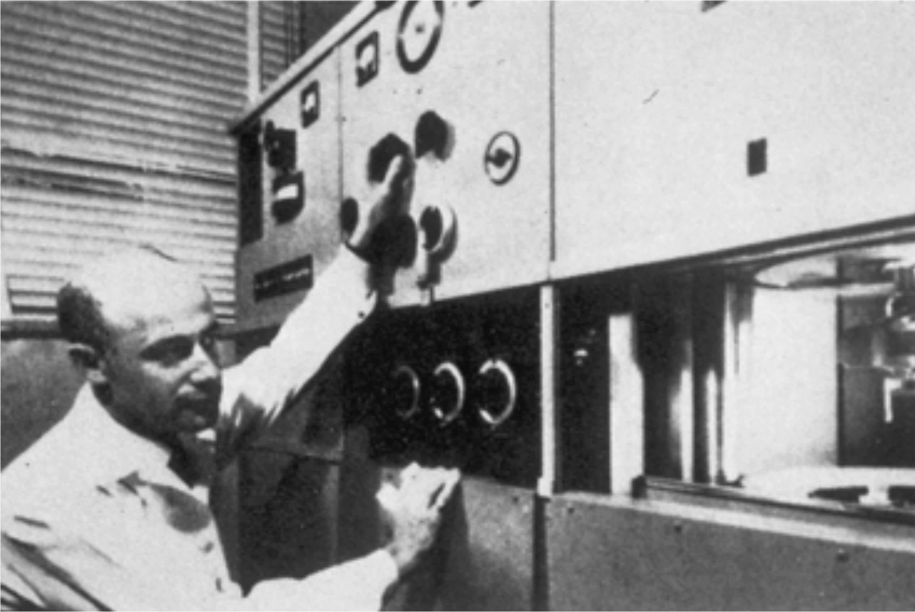
LDL AND HDL TO THE RESCUE
John Gofman preparing to fire up his analytical ultracentrifuge for a lipoprotein separation (circa 1948). This was only the second instrument of its kind at the time.
Notes:
The problem was that rabbits don't eat meat and attempts to reproduce atheroma lesions in experimental animals that did failed completely. In addition, nobody cared. Coronary heart disease was not a major problem since many people didn’t live long enough to die from it. Moreover, cholesterol is a large, inert molecule and it was hard to understand how it could infiltrate the intimal lining of a coronary artery to incite an inflammatory response. Few physicians or researchers in the U. S. knew anything about Anitschkow or his hypothesis but one exception was John Gofman who took it very seriously. He had a Ph.D.> in nuclear phyiscs and after graduating from medical school in 1946,Gofman was particularly excited about the potential of a highly sophisticated new analytic ultracentrifugation technique that had been developed in Sweden by the Nobel Laureate Theodor Svedberg. It was invaluable for measuring the molecular size and concentrations of proteins and Gofman thought he could use it to characterize lipoproteins in human serum in an effort to explain Anitschkow’s findings. Gofman developed special flotation ultracentrifugal techniques that demonstrated the existence of diverse low-density lipoproteins (LDL) and high-density lipoproteins (HDL). His group subsequently showed in a series of studies that LDL (bad cholesterol) was responsible for the rapid progression of atherosclerosis in humans and that HDL (good cholesterol) had the opposite effect. This produced an avalanche of research in cholesterol-induced atherosclerosis in the mid-1950s that turned the relatively obscure Anitschkow into an international celebrity

Slide 8
THE FRAMINGHAM STUDY
The Framingham study, which began around the same time, has had the most impact on CHD research. It established cholesterol, cigarette smoking and hypertension as the leading causes of coronary disease. Other risk factors were added later and all of these had additive effects.
William Kannel, Director of the Framingham Study during the 1960’s, told the press that the Framingham results essentially proved that cholesterol was a powerful predictor of CHD.
A 1987 30 year follow-up study stated "The most important overall finding is the emergence of the total cholesterol as a risk factor for CHD in the elderly". No data were presented to support this erroneous claim.
Notes:
Between 1948 and 1951, 1,980 men and 2,421 women were enrolled in an observational study in Framingham, Massachusetts. The 1st report of this long-term study, “Factors of risk in the development of coronary heart disease—six-year follow-up experience; the Framingham Study,” was published in the Annals of Internal Medicine in 1961. T
he study showed that high blood pressure, smoking, and high cholesterol levels were major factors in heart disease. From this report, the concept of risk factors emerged, and, with further elaboration through the years, the study provided health professionals with multifactorial risk profiles for cardiovascular disease. These profiles assisted in the identification of candidates who might benefit from preventive measures

Slide 9
A FEW FRAMINGHAM FALLACIES
A dietary analysis study in the 1950's found that participants had widely varying cholesterol levels and concluded that "something explains this inter individual variation but it is not diet.” It was never published.
With respect to high cholesterol causing more heart attacks, the data actually revealed that the incidence of heart attacks was relatively constant from levels of 200 to 1000.
A direct correlation was reported between falling cholesterol levels over the first 14 years of the study and increased mortality over the following 18 years. For men older than 47, those with low cholesterol had mortality rates greater than those with high cholesterol.
Men whose cholesterol had decreased spontaneously over 30 years were at greater risk of dying from heart disease compared to those whose cholesterol had increased. "For each 1% mg. drop in cholesterol there was an 11% increase in coronary and total mortality."

Slide 10
SOME MORE FRAMINGHAM FLAWS
Although the study found that each 1% drop in cholesterol was associated with an 11% increase in coronary deaths, a joint AHA-NIH publication cited it as supporting the cholesterol-CHD link in 1990 by claiming that “The results of the Framingham study indicate that a 1% reduction in cholesterol corresponds to a 2% reduction in CHD risk.”
The real truth about diet and cholesterol had been revealed in a 1972 Archives Of Internal Medicine article showing that the more saturated fat and the more cholesterol people ate, the lower their serum cholesterol was. Those who ate the most cholesterol and saturated fats also weighed the least. The author was William Castelli, Director of the Framingham study at the time.
Notes:
DISCUSS SLIDE

Slide 11
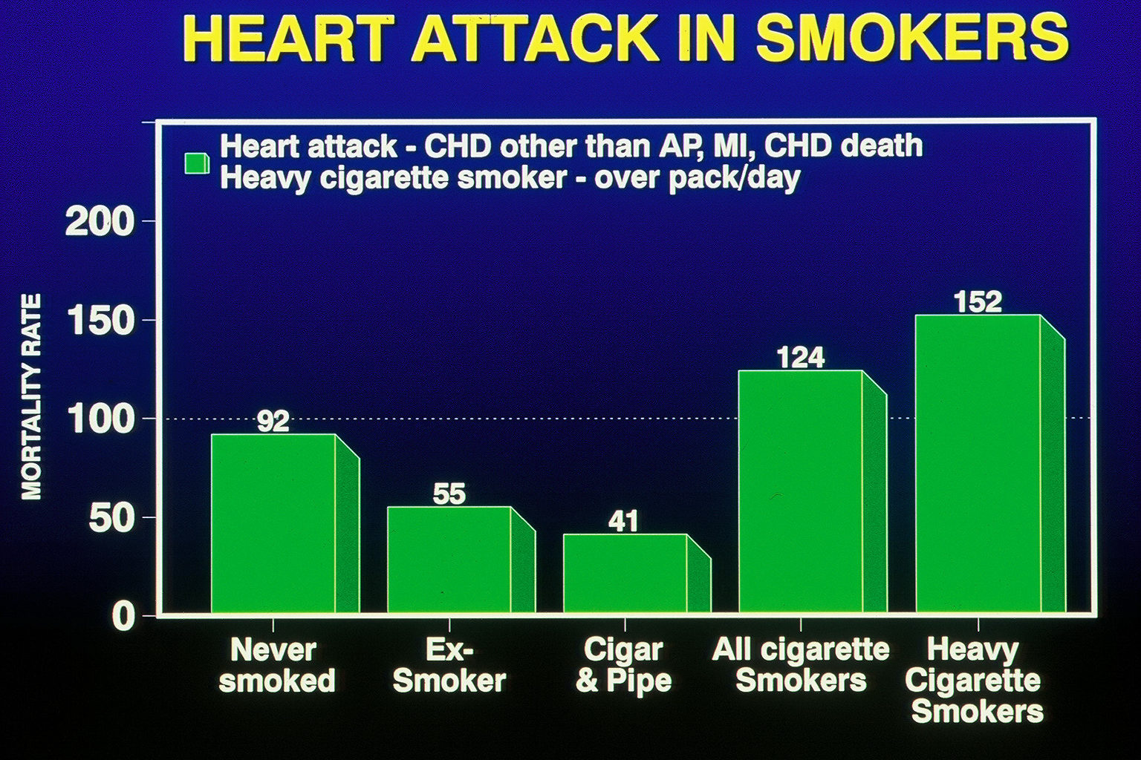
CARDIAC DEATHS IN SMOKERS
DATA FROM THE FRAMINGHAM STUDY (Courtesy of Dr. William Castelli)
Notes:
A lot of interesting Framingham data was not published, although in In a 1996 article in Arteriosclerosis, Castelli also admitted that a 26-year follow-up found that 50% of coronary heart disease occurred in people with below average cholesterol. Also not published was that although iincreased smoking was associated with increased deaths from heart disease, ex-smokers had 40 % fewer deaths and cigar and pipe smoker had 56% less deaths compared to those who never smoked Logical conclusion from this is that everybody should start smoking cigars or a pipe
Statistics are a highly logical and precise method for stating a half-truth inaccurately
SAID BEFORE STATISTICS ARE A WAY OF SAYING A HALF TRUTH INACCURATELY

Slide 12
FRAMINGHAM AND ANITSCHKOW TRIUMPH
In 1958, Dr. William Dock, an eminent cardiologist and pathologist, wrote in an Annals of Internal Medicine editorial, "Thus the early work of Anitschkow bears comparison with that of Harvey on the circulation of the blood and of Lavoisier on the respiratory exchange of oxygen and carbon dioxide." Dock compared the significance of Anitschkow’s contributions to Koch’s discovery that the tubercle bacillus caused tuberculosis.
Cardiology's Ten Greatest 20th Century Discoveries
1. The Electrocardiogram
2. Preventive Cardiology and the Framingham Study
3. “Lipid Hypothesis” (Anitschkow and Atherosclerosis)
Notes:
Cardiology's 10 Greatest Discoveries of the 20th Century. Tex Heart Inst J. 2002;
1. ecg
2. Preventive Cardiology and the Framingham Study
3. “Lipid Hypotheses” Anitschkov and Atherosclerosis

Slide 13
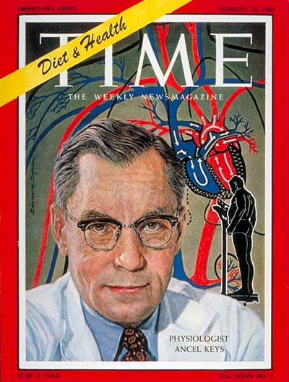
SEVEN COUNTRIES STUDY
Straight line relationship between fat consumption, serum cholesterol and heart disease deaths in healthy men.
Eastern Finland - saturated fat over 20% of total calories, cholesterol over 260, 70 fatal heart attacks per 1,000 men over 10 years.
Japan - saturated fat 2.5% of total calories, cholesterol 160, less than five fatal heart attacks per 1,000 men over 10 years.
"No other variable in the mode of life beside the fat calories in the diet is known which shows such a constant relationship to the mortality rate from coronary or degenerative heart disease.”
Notes:
Anitschkow also got a big boost from Ancel Keys, who proposed in 1953 that heart disease resulted from high cholesterol, which was due to increased saturated fat intake Keys subsequently embarked on his famous Seven Countries Study in healthy middle-aged men that showed a remarkable straight-line relationship between saturated fat consumption, serum cholesterol and deaths from coronary disease. In East Finland, where serum cholesterol averaged over 260, the number of fatal heart attacks per 1,000 men over a 10-year period was about 70. In contrast, Japan had less than 5 such deaths, which Keys attributed to the fact that the average cholesterol was about 160. The contribution of saturated fats to the total daily caloric intake in Finnish men was over 20%, almost ten times higher than the 2.5% for Japanese men. He concluded that risk of fatal heart attacks was proportional to the blood cholesterol level, which, in turn, was proportional to saturated fat intake. This was widely heralded as definitive proof of these causal links, and one leading authority triumphantly proclaimed, "No other variable in the mode of life beside the fat calories in the diet is known which shows such a constant relationship to the mortality rate from coronary or degenerative heart disease”.

Slide 14
FIGURES DON’T LIE, BUT LIARS CAN FIGURE
Although Keys had 22 countries to choose from, he selected only those that supported his theory. Had all the countries been included, the results would have been quite different. Figures from Israel, Sweden, Germany and France would have led to the conclusion that the more saturated fat and cholesterol that were consumed, the lower the incidence of deaths from coronary heart disease.
The average cholesterol level in Crete was 202, but although it was 198 on the island of Corfu, coronary deaths were 5 times higher. Residents of Montegiorgio and Crevalcore, two Italian districts,, had identical average cholesterol levels but death rates from heart disease were 2.5 times higher in Montegiorgio. Cholesterol levels within other nations also varied, which is why Keys specified Eastern Finland.
People in the Gascon region of France slathered goose and fat duck on bread, ate twice as much foie gras as the rest of the country and 50 times more than Americans. Yet, 315/1000 middle aged U.S. men died of heart attacks/year compared to 145 in France and 80 in Gascon.
Notes:
Gascon. where most adults also smoke.

Slide 15
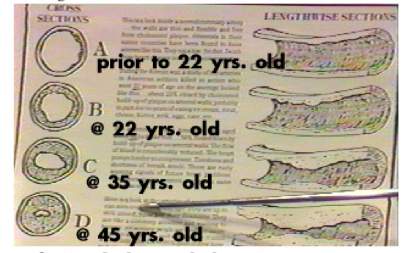
PROGRESSIVE ATHEROSCLEROSIS WITH AGING IN
AMERICAN SOLDIERS KILLED IN THE KOREAN WAR
Fat And Cholesterol Clogging Up The Coronaries
Notes:
However, the public was thoroughly convinced that dietary fat caused a buildup of cholesterol that clogged the coronary arteries. Proof came from pictures like this of autopsy studies in young Americans killed in the Korean conflict. that made headlines in 1955. Analysis of the plaques showed they were composed of cholesterol and saturated fat, and it was alleged that few such lesions were found in dead Korean and Chinese soldiers, which was attributed to their much lower saturated fat diet.
However, another report in 1956 that was not publicized found that Japanese natives had almost as much age related plaque despite their low fat diet. A 1957 study of the largely vegetarian Bantu found that they had the same amount of plaque buildup in the arteries as other South African races that ate large amounts of meat. A 1958 report noted that although Jamaican Blacks showed a degree of atherosclerosis comparable to that found in the U.S.A., they had much lower rates of heart disease. The 1968 International Atherosclerosis Project, which compared the results from 22,000 autopsies performed in 14 nations, showed the same degree of atheromatous plaque in all parts of the world. This included populations that consumed large amounts of fatty animal products and others that were primarily vegetarians. The severity of atherosclerosis was also similar in countries that had high rates of heart disease and others where the incidence was extremely low. All of these studies pointed to the fact that atherosclerotic thickening of the arterial walls is a natural and unavoidable process that is not significantly influenced by diet.

Slide 16
THE LOW CHOLESTEROL DIET CRAZE
The Anti-Coronary Club Project launched in 1957 compared two groups of New York businessmen 49 to 59 years old. One group followed a "Prudent Diet" with corn oil and margarine instead of butter, cold cereal rather than eggs, and chicken and fish instead of beef. A control group ate eggs for breakfast and meat three times per day. The results published a decade later revealed that cholesterol levels of those on the Prudent Diet averaged 30 points lower than the control group eating eggs and meat but there were eight deaths from heart disease in the Prudent Dieters compared to none in the controls.
In a further attempt to prove his point, Keys fed middle-aged men a very high cholesterol diet but found that their blood cholesterols were no different than a control group who consumed less than half as much. Twenty years later, he was forced to admit, "There’s no connection whatsoever between cholesterol in food and cholesterol in blood. And we’ve known that all along. Cholesterol in the diet doesn’t matter at all unless you happen to be a chicken or a rabbit. "

Slide 17
Review Of Over 2000 Studies On The Links Between
Dietary Cholesterol, Fat, Heart Disease And Health
"The word 'landmark' has often been used to describe Ancel Keys’ Seven Countries study, commonly cited as proof that the American diet is atherogenic. . . . the dietary assessment methodology was highly inconsistent across cohorts and thoroughly suspect. In addition, careful examination of the death rates and associations between diet and death rates reveal a massive set of inconsistencies and contradictions. It is almost inconceivable that the Seven Countries study was performed with such scientific abandon. It is also dumbfounding how the NHLBI/AHA alliance ignored such sloppiness in their many "rave reviews" of the study. . . In summary, the diet-CHD relationship reported for the Seven Countries study cannot be taken seriously by the objective and critical scientist. ” - Russell H. Smith

Slide 18
THE MRFIT STUDY
The Multiple Risk Factor Intervention Trial was the largest and most serious effort to prove the links between diet, cholesterol and heart disease based on the Framingham risk factors. Researchers screened over 350,000 men at high risk of heart disease because of high cholesterol, hypertension and cigarette smoking.
From this group, 12,866 healthy men aged 35 to 57 with no history or evidence of heart disease were enrolled in the study and randomly assigned to either an intervention group that received treatment or a control group the same size that received usual care.
In the treatment group, cholesterol consumption was cut by 42% and saturated fat consumption by 28%. After ten years, those adhering to this dietary fat restriction had slightly lower coronary heart disease mortality rates. However, this benefit was far outweighed by significantly increased total death rates, especially from hemorrhagic stroke, cancer, suicide, accidents and violence.
Notes:
The MRFIT acronym for Multiple Risk Factor Intervention Trial study costing $115 million results were published in 1982

Slide 19
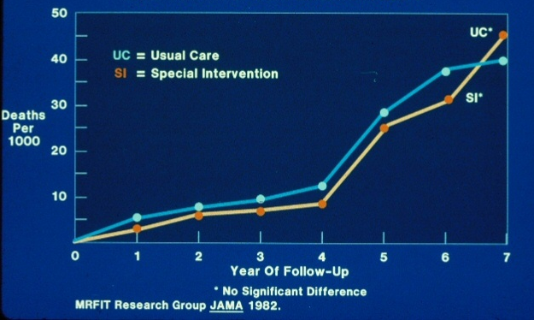
MR FIT CUMULATIVE TOTAL MORTALITY
Notes:
No significant difference on follow up

Slide 20
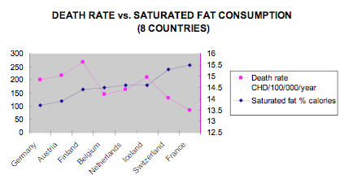
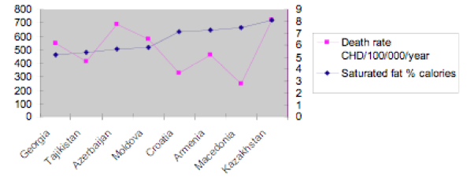
MONICA CHD DEATHS AND FAT CONSUMPTION
The eight lowest
saturated fat consumption countries had the highest CHD death rates
The eight highest
saturated fat consumption countries had the lowest CHD death rates
Notes:
The World Health Organization project MONICA (Monitoring of Trends and Determinants in Cardiovascular Disease) a huge cardiovascular epidemiologic study, assessed 21 countries over 10 years. It also failed to find any correlation or connection between heart attacks and fat consumption or cholesterol. Every single country with the lowest fat consumption had the highest mortality rates from heart disease and those with the most fat consumption had the highest. The French consumed three times as much saturated fat compared to Azerbaijan but had one-eighth the rate of heart disease

Slide 21
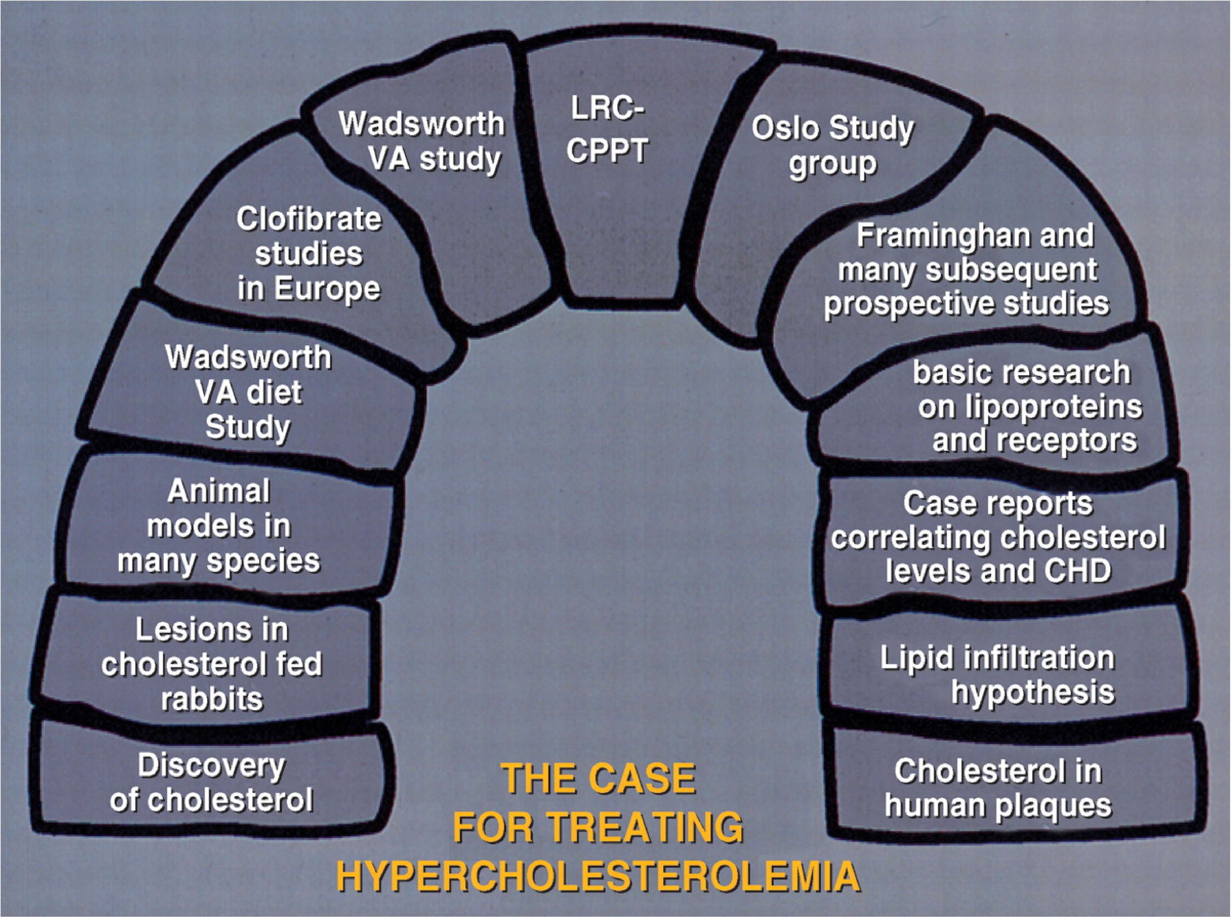
1984 PRIMARY PREVENTION PRESENTATION SLIDE SHOWING AN "ARCH
OF EVIDENCE" THAT SUPPORTED THE CPPT KEYSTONE STUDY RESULTS.
Notes:
What the cholesterol crusaders desperately needed was something to show that lowering cholesterol reduced heart attacks. In 1984, their prayers were answered with the publication of the Lipid Research Clinics’ Coronary Primary Prevention Trial. It suggested that cholestyramine could reduced major coronary events in 50% of all men with high cholesterols within 7 years. 1984 was also a bonanza because the NIH Consensus Conference on Lowering Blood Cholesterol to Prevent Heart Disease declared that lowering blood cholesterol should be a public health goal for everyone and the National Cholesterol Education Program was established to teach physicians and patients how to diagnose and deal with high cholesterol.
Bile acids, which are made from cholesterol, aid in the digestion of fats in the small intestine. Cholestyramine binds to bile acids and since the drug is not absorbed, it and the bile acids are excreted, and more cholesterol has to be extracted from the blood to replenish the supply. Although the 50% drop in cholesterol was not achieved, researchers triumphantly reported that there was a 19% reduction in the study group,
All of this was trumpeted in a massive media blitz referring to additional studies that provided strong support for these activities to reduce if not eradicate coronary heart disease. The lead article in one journal was "The Lipid Hypothesis Is Proven" and Postgraduate Medicine’s cover proclaimed, "Coronary disease prevention: Proof of the anticholesterol pudding “
The keystone of this ambitious arch was clearly the Coronary Primary Prevention Trial but it was just as weak as the other building blocks

Slide 22
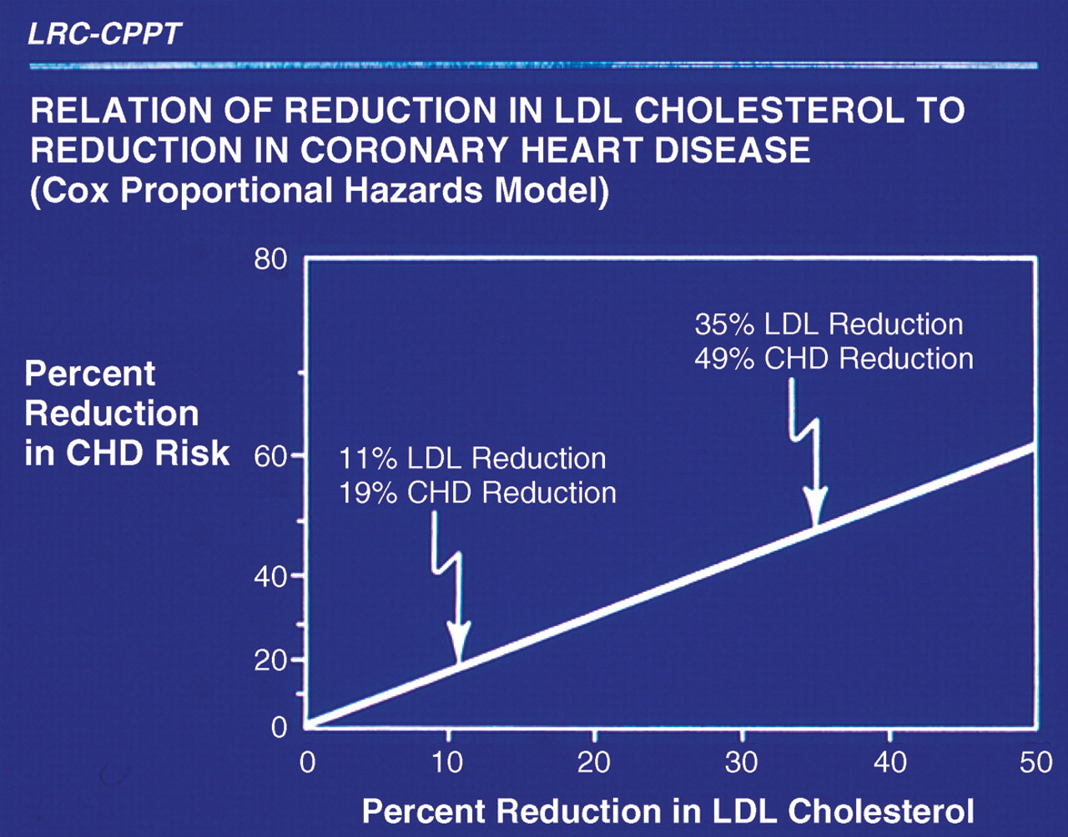
CHOLESTYRAMINE CORONARY PRIMARY PREVENTION TRIAL
But 19% was the relative risk based on estimated LDL lowering. The actual risk of coronary events was 1.1%, and for fatal heart attacks, the risk difference was only 0.6%. The graph to the left does not indicate this. It simply shows the predicted relative risk reduction in coronary heart disease anticipated with the progressive lowering of cholesterol. Moreover, the study dealt only with men that had very high levels that affects less than one in five hundred, and a very small fraction of the total number of deaths due to heart attacks. There was no indication that it would lower cholesterol in other men or women or that longer term use would be safe.
For Every 1% Fall In Cholesterol There Will Be A 2% Reduction In Coronary Events
Notes:
George Mann, Professor of Biochemistry at Vanderbilt and one of the original Framinghmam investigators, was particularly appalled at all the hoopla and recommendations, and said this about the CPPT panel
"They have held repeated press conferences bragging about this cataclysmic break-through which the study directors claim shows that lowering cholesterol lowers the frequency of coronary disease. They have manipulated the data or reached the wrong conclusions. . . . The managers at NIH have used Madison Avenue hype to sell this failed trial in the way the media people sell an underarm deodorant.” He was later to pay dearly for this
What George was referring to was that treatment with cholestyramine, a bile acid binding resin reduced relative risk for major coronary events by 19%. Some men stopped taking the foul tasting 4 to 5 packets of cholestyramine after a few days, many complained of severe constipation and other gastrointestinal complaints due to the lack of bile acids. Most were unable to take the full 24 grams daily, so that relatively few stayed on the required regimen for seven and a half years. In addition, only 35-59 year old men with extremely high cholesterols were included and there was no indication that lowering cholesterol in women or men in other age groups without elevated cholesterol would provide any benefits or be safe. With respect to safety, cholestyramine interferes with the absorption of fat soluble vitamins and numerous common drugs, including Coumadin, Digoxin, Inderal, phenobarbital, thiazide diuretics and thyroid medications. There was little mention of the 21 cases and 8 deaths from gastrointestinal cancer in those taking the drug, compared to 11 cases and only 1 death in the control group. Although there were fewer deaths from heart attacks there was no decrease in total mortality, especially from accidents, homicide, suicide and cancer.
More importantly, the projection that 50% would benefit was based on the same flawed relative risk conclusions of other cholesterol lowering studies. 19% was a relative risk reduction from lowering LDL cholesterol. The actual risk reduction was 1.1% for all coronary events, and for fatal heart attacks, it was only 0.6%. With respect to the claim that for every 1% fall in cholesterol there would be a 2% reduction in coronary events, an independent review later found this to be false. And a 30-year follow up of the Framingham data subsequently demonstrated that "For each 1% mg/dl drop of cholesterol there was an 11% INCREASE in coronary and total mortality.

Slide 23
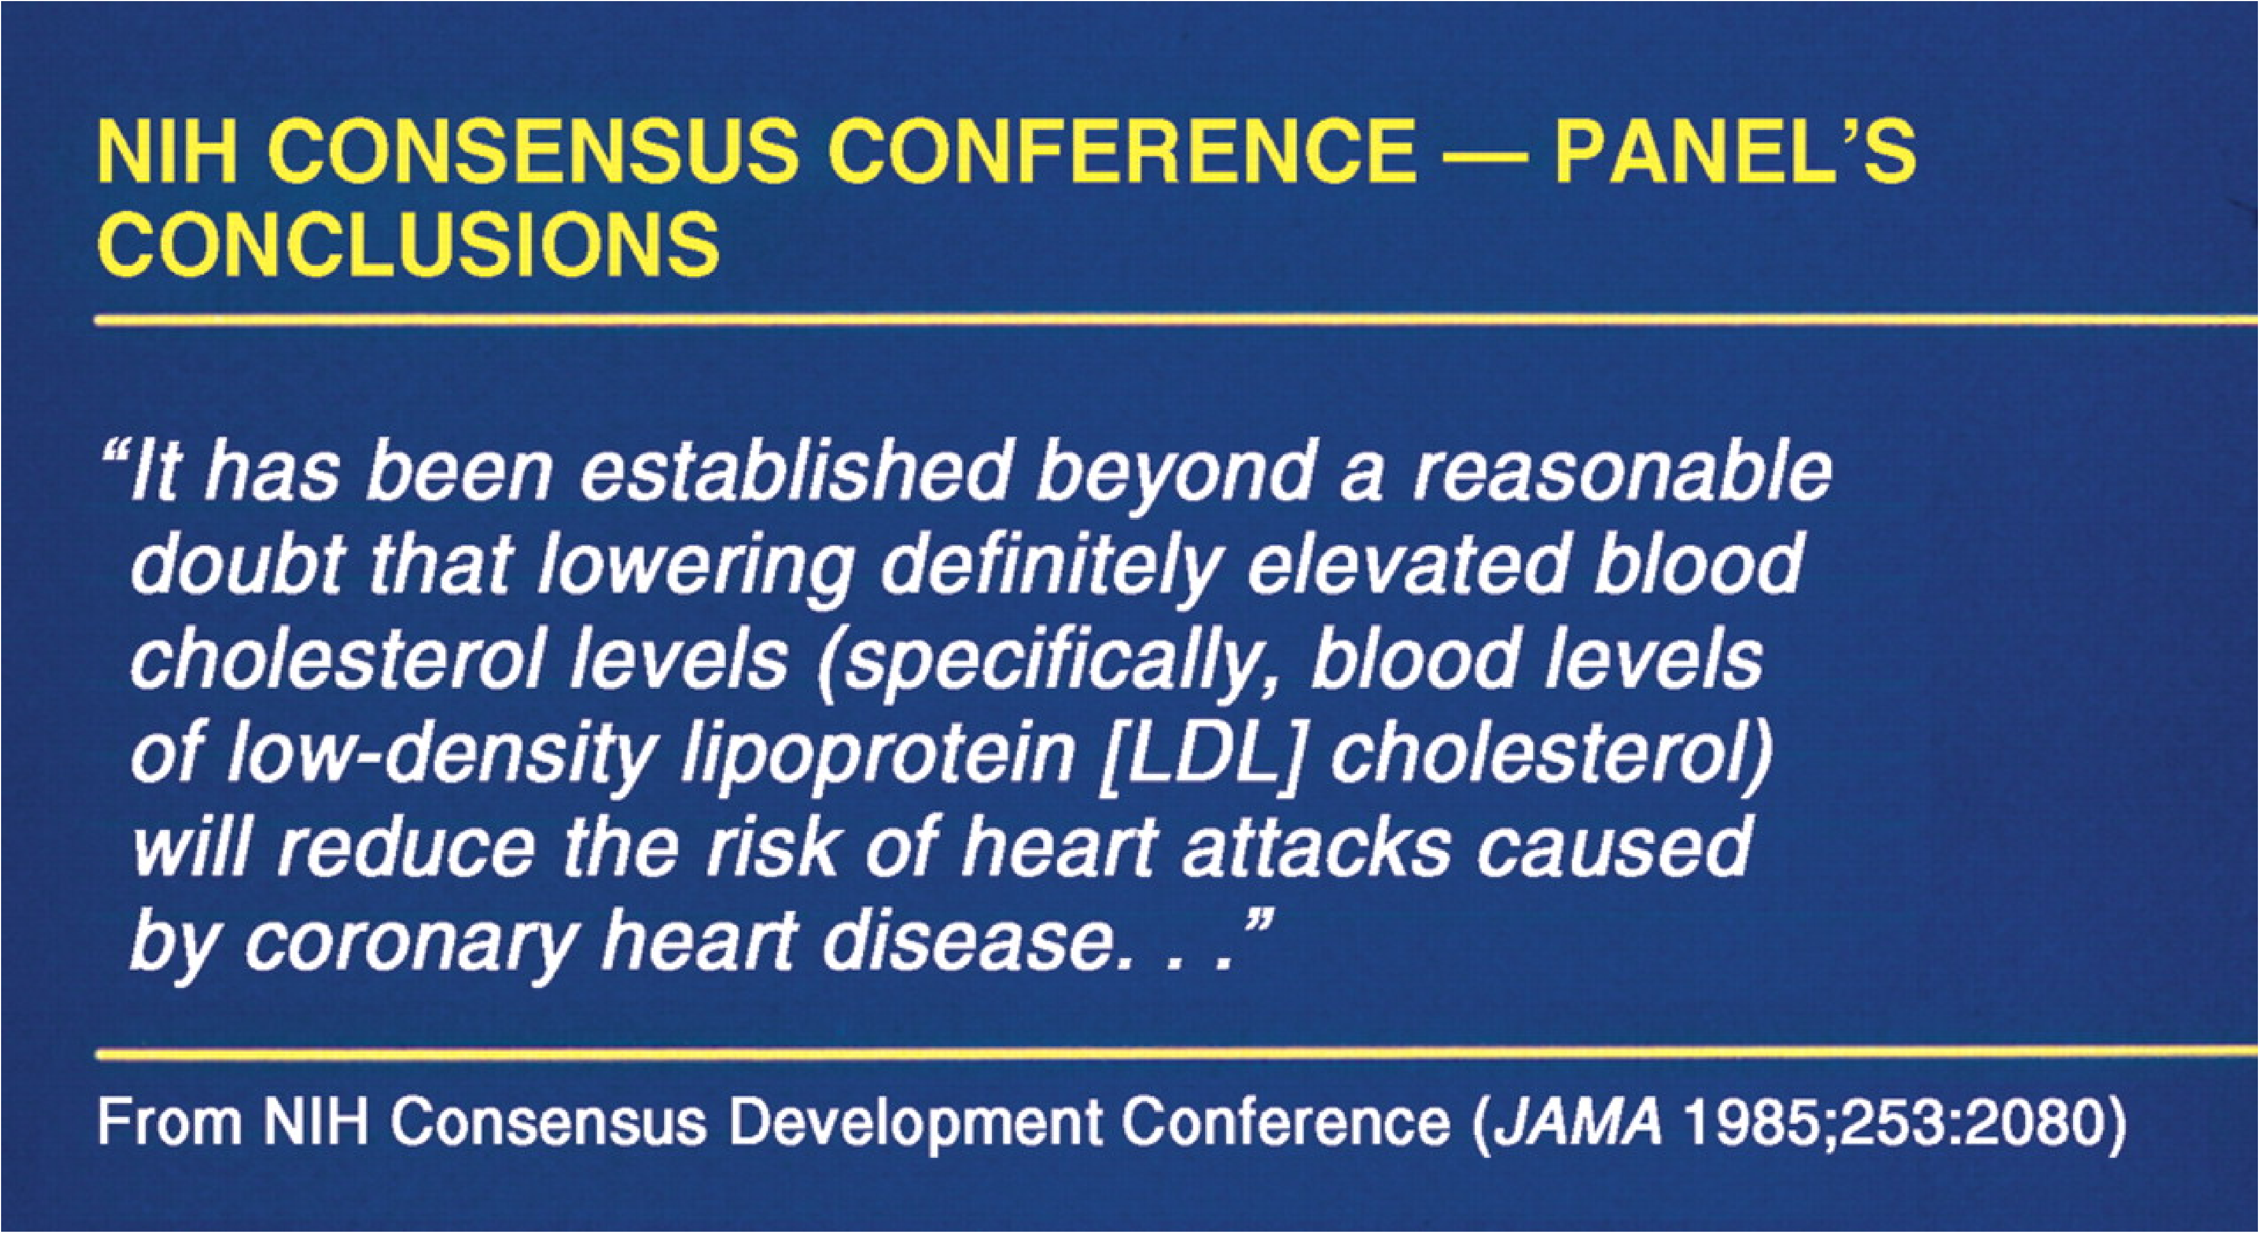
Major Conclusion of the NIH 1984 Consensus Panel
Notes:
Note that the Panel’s conclusions, which were widely endorsed only referred to reducing the risk of heart attacks not reducing heart attacks and now shift the emphasis to lowering LDL, which is equally erroneous
SAME FOR STATINS.
Never see an add that says reduces heart attacks, if you look at the fine print on the bottom in mice type
Lipitor has NOT been shown to prevent heart disease or heart attacks.”
”Crestor has NOT been shown to prevent heart disease or heart attacks

Slide 24
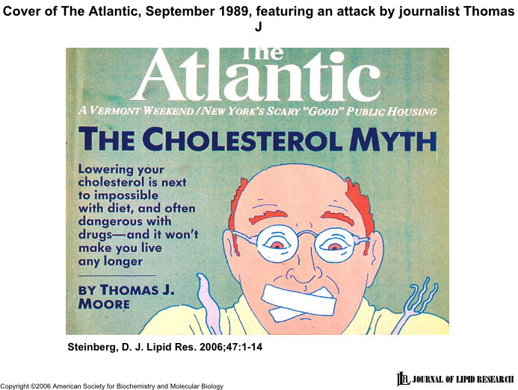
Cover of The Atlantic, September, 1989
Notes:
There were other critics Moore, a medical journalist from Washington. Blistering attack
"The dissenters have been overwhelmed by the extravaganza put on not just by the heart institute but by a growing coalition that resembles a medical version of the military-industrial complex. This coalition includes ... the ‘authorities’ ... The National Heart, Lung and Blood Institute] itself ... and the American Heart Association.” He named five lipid investigators who had offered to make themselves available to answer questions about the statins, which had just been introduced by Merck for clinical use pointing out “It is likely that one reason these physicians consented to such an arrangement is that their laboratories were heavily involved in research funded by Merck.”
IN 2001 Gary Taubes, an excellent researcher and writer also wrote a scathing denunciation of the dietary fat dogma published in Science. He listened to the tapes of the 1984 conference and none of the dissenting views were present in the report which arbitrarily lowered the accepted 240 level of cholesterol to 200. He presented the graph which showed quite clearly that serum cholesterol levels of 200 mg/dl to 240 mg/dl were definitely in the normal cholesterol range for which there was no increased risk of heart mortality in males and even above 240 mg/dl there was a decrease in risk for women. However, few physicians dared to get in the way of the cholesterol cartel's juggernaut.

Slide 25
SUPPORT FROM RECENT STUDIES
A review of 21 studies representing 350,000 people followed for up to 23 years found “no evidence that saturated fat is associated with an increased risk of cardiovascular disease.” AJCN, March 2010
An Australian 15-year study found that adults who ate the most full-fat dairy products had a 70 percent lower risk of cardiac death than those who ate the least. People who avoided or ate only low fat dairy foods were over three times more likely to die from heart disease or stroke EJCN, June 2010
Japanese longer life expectancy and lower heart disease rates have been attributed to their largely vegetarian and fish diet with little saturated fat. A long term study just confirmed that high saturated fat intake was associated with fewer deaths from heart disease, as well as ischemic and hemorrhagic strokes. AJCN Aug, 2010
.

Slide 26
WHY THE LIPID HYPOTHESIS IS WRONG
No dietary cholesterol lowering trial has ever resulted in a reduction of coronary disease or total mortality rates.
Over two dozen studies have reported that coronary heart disease patients ate less or the same amount of saturated fat as healthy controls.
The MONICA project found that increased saturated fat consumption was associated with a decrease in coronary deaths. The reverse was true for low fat diets.
Notes:
The New England Journal of Medicine published a well documented study of an 88-year old man who for psychological reasons had consumed. 20 to 30 eggs daily for at least 15 years. He had no elevation of cholesterol or lipids, a normal cardiogram and no signs or symptoms of heart disease.
George Mann studied the Masai, a Kenyan cattle-herding tribe, and found them to be free of heart disease, despite a diet consisting almost entirely of meat, blood, and milk, whose parties sometimes consist of eating four to six pounds of meat per person.

Slide 27
WHY THE LIPID HYPOTHESIS IS WRONG
The Framingham study similarly showed that the more saturated fat and the more cholesterol people ate, the lower their serum cholesterol was.
No clinical or imaging study has found any relation between the degree of cholesterol lowering and improvement. In one angiography study in which blood cholesterol had been reduced by more than 25% in 24 patients, atherosclerosis was increased in 18 and unchanged in eight.
No association between cholesterol levels and the severity or extent of atherosclerosis has ever been found in autopsy studies of the general population.
Notes:
A Mayo Clinic study similarly found that in all patients whose cholesterols had decreased by more than 60 mg., there was a significant increase in coronary atherosclerosis.
A 26 year Framingham follow-up study found that 50% of all coronary heart disease occurs in people with below average cholesterol
Since the cardioprotective and other benefits of statins are not related to lowering lipids, the current therapy goals of lowering LDL to arbitrary levels that are usually difficult to achieve will only lead to larger doses and more side effects.
Inflammation plays a major role in the initiation and all phases of the development of atherosclerotic plaque and involves a variety of complex interrelated activities.
Stress can contribute to the pathogenesis of coronary heart disease through pathways other than those appreciated with our current chemical/molecular model of communication. There is an emerging paradigm of communication at a physical/atomic level that may explain this as well as the success of novel energy treatment approaches.
The New England Journal of Medicine published a well documented study of an 88-year old man who for psychological reasons had consumed. 20 to 30 eggs daily for at least 15 years. He had no elevation of cholesterol or lipids, a normal cardiogram and no signs or symptoms of heart disease.
George Mann studied the Masai, a Kenyan cattle-herding tribe, and found them to be free of heart disease, despite a diet consisting almost entirely of meat, blood, and milk, whose parties sometimes consist of eating four to six pounds of meat per person.

Slide 28
WHY THE LIPID HYPOTHESIS IS WRONG
High cholesterol does not increase risk for heart attacks in people older than 65, women of any age, as well as patients with diabetes or renal failure. Senior citizens with high cholesterols have significantly fewer infections and live longer than low cholesterol controls.
In familial hypercholesterolemia, there is no correlation between the very high cholesterol and LDL levels and any increased incidence or prevalence of coronary disease.
A recent national study reported that "Almost 75
percent of heart attack patients fell within current
recommended targets for LDL cholesterol”.

Slide 29
WHY THE LIPID HYPOTHESIS IS WRONG
A Mayo Clinic study similarly found that in all patients whose cholesterols had decreased by more than 60 mg. there was a significant increase in coronary atherosclerosis.
A 26 year Framingham follow-up study found that 50% of all coronary heart disease occurs in people with below average cholesterol
George Mann studied the Masai, a Kenyan cattle-herding tribe, and found them to be free of heart disease, despite a diet consisting almost entirely of meat, blood, and milk. Parties sometimes consisted of eating four to six pounds of meat per person.
Notes:
The New England Journal of Medicine published a well documented study of an 88-year old man who for psychological reasons had consumed. 20 to 30 eggs daily for at least 15 years. He had no elevation of cholesterol or lipids, a normal cardiogram and no signs or symptoms of heart disease.
Since the cardioprotective and other benefits of statins are not related to lowering lipids, the current therapy goals of lowering LDL to arbitrary levels that are usually difficult to achieve will only lead to larger doses and more side effects.
Inflammation plays a major role in the initiation and all phases of the development of atherosclerotic plaque and involves a variety of complex interrelated activities.
Stress can contribute to the pathogenesis of coronary heart disease through pathways other than those appreciated with our current chemical/molecular model of communication. There is an emerging paradigm of communication at a physical/atomic level that may explain this as well as the success of novel energy treatment approaches.
The New England Journal of Medicine published a well documented study of an 88-year old man who for psychological reasons had consumed. 20 to 30 eggs daily for at least 15 years. He had no elevation of cholesterol or lipids, a normal cardiogram and no signs or symptoms of heart disease.

Slide 30
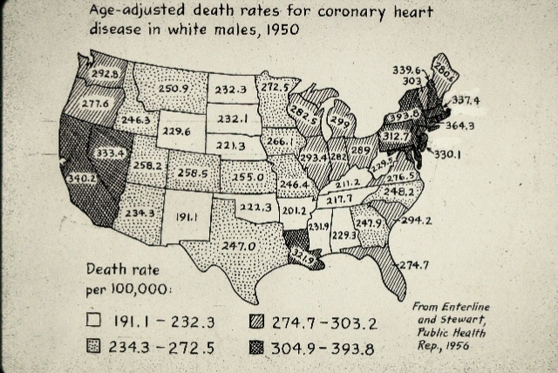
AGE-ADJUSTED DEATH RATES FOR CORONARY
HEART DISEASE IN WHITE MALES, 1950
Courtesy of Dr. Ray Rosenman
Notes:
During the 1950 epidemic of heart attacks the highest incidence was in Northeast and Western manufacturing states and lowest in Mid West farming and dairy states where fat consumption was the highest.

Slide 31
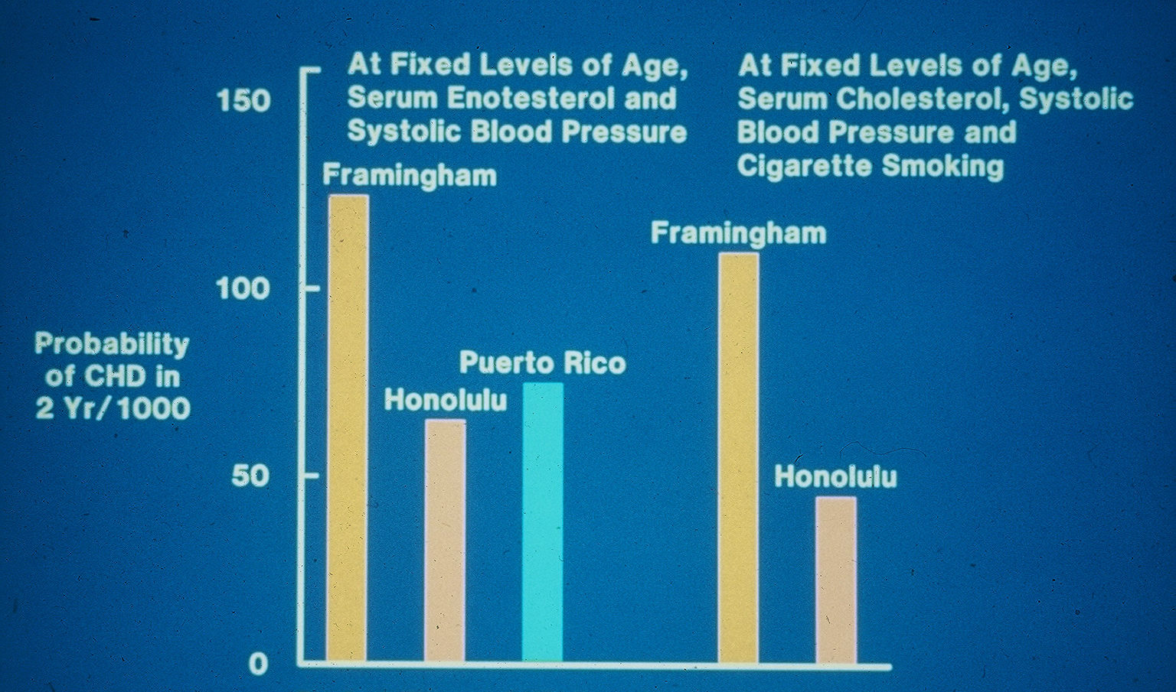
PROBABILITY OF CHD DEVELOPING IN 2 YEARS
WITH SAME RISK FACTORS AT DIFFERENT SITES
Courtesy of Dr. Ray Rosenman
Notes:
Ray noted that heart attacks in Americans were least likely to occur in places where they took their vacations.

Slide 32
THE HEART IN ANTIQUITY
The Bible portrays the heart as the seat of emotions such as fear, love, sorrow courage, joy, and especially anger and hatred. In some instances, the heart also depicted personality and the ability to distinguish right from wrong, or conscience.
The ancient Chinese thought it was the source of happiness.
A very old Hindu scripture, the Gita, describes the Paramatma as the supreme soul that resides in the heart of every living entity. The heart chakra was also the location of complex emotions like compassion, tenderness and unconditional love.
The Greeks (Aristotle) and Romans (Virgil) believed the heart was the seat of the mind as well as the soul and mind.
Ancient Egyptians likely influenced this, as they regarded the heart, rather than the brain, as the source of wisdom, emotions, memory, personality and character, as well as the soul.
Notes:
Papyri written prior to 1500 B.C. describe the metu, channels emanating from the heart that disseminated energy and information to other parts of the body by delivering not only blood, but air, nutrients, tears and saliva. Good health depended on the metu being clear and not blocked, much like an irrigation canal from the Nile cannot deliver water if it is blocked. Similarly, most diseases were treated by attempting to dredge the metu, regulate, balance, and restore its normal function, or remove noxious substances. These efforts started with the heart, which was the only major organ not removed during mummification. The only function of the brain was thought to be to pass mucus to the nose, so it was discarded

Slide 33
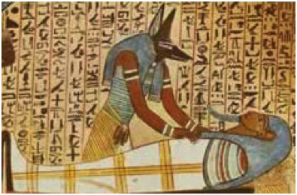
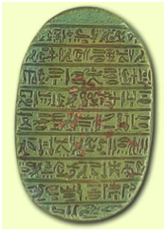
Anubis, God Of The Underworld Protective Scarab
Anubis the God of the Underworld and Embalming, who guided and protected the spirits of the dead, was depicted as a black jackal-headed man. This may be because jackals often prowled around graveyards and an embalmed body turned a pitch black color. Black was also the color of fertility and thus linked to death and rebirth in the afterlife, where the heart would be returned to the deceased by Anubis.
To prevent the heart from providing damaging testimony during the final judgment, a scarab was often wrapped within the bandages containing inscriptions from the Book of the Dead, such as “O my heart which I had upon earth, do not rise up against me as a witness in the presence of the lord of things; do not speak against me concerning what I have done, do not bring up anything against me in the presence of the great god of the West.”
Notes:
Papyri written prior to 1500 B.C. describe the metu, channels emanating from the heart that disseminated energy and information to other parts of the body by delivering not only blood, but air, nutrients, tears and saliva. Good health depended on the metu being clear and not blocked, much like an irrigation canal from the Nile cannot deliver water if it is blocked. Similarly, most diseases were treated by attempting to dredge the metu, regulate, balance, and restore its normal function, or remove noxious substances. These efforts started with the heart, which is why it was the only major organ not removed during mummification. The only function of the brain was thought to be to pass mucus to the nose, so it was discarded
Anubis the god of the underworld and embalming, who guided and protected the spirits of the dead, was generally depicted as a black jackal-headed man. This is probably because jackals often prowled around graveyards, and an embalmed body turned a pitch black color.
Black was also the color of fertility and therefore linked to death and rebirth in the afterlife, where the heart was thought to be given back to the deceased by Anubis. that the heart might testify against the deceased, so in order to prevent this, a heart scarab was often wrapped within the bandages. The inscription on the scarab would most likely consist of Chapter 30 from the Book of the Dead:

Slide 34
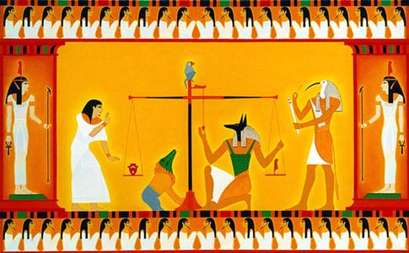
In the final judgment portrayed by the Book of the Dead, the heart of the deceased was shown being weighed against the feather of Ma'at, a symbol of universal truth, harmony and balance. Anubis was sometimes shown adjusting the balance of the scales slightly in favor of the deceased, to insure safe entry into the underworld
Notes:
Ancient Egyptian civilization was based on their belief in the rebirth after death became their driving force behind their funeral practices. Death was simply a temporary interruption, rather than complete cessation, of life, and eternal life could be ensured by obeying the gods and preservation of the physical form through Mummification. During the Middle Kingdom, Anubis was replaced as the God of the underworld by Osiris, who was also worshipped as a God of fertility, resurrection, and vegetation.

Slide 35
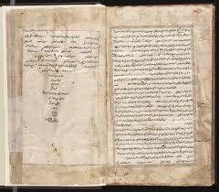
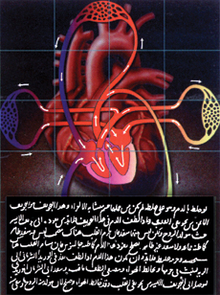
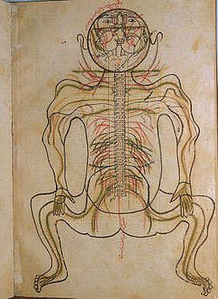
THE HEART IN ISLAM
Ibn Sina (Avicenna) Abn al Nafis Mansur ibn Ilyas
Both the Quran and Hadeeth emphasized the heart as the center for emotions, attitude and intellect. It is the heart that "softens" or “hardens". "It is the hearts of the disbelievers that are blind, not their eyes", and “who have hearts that do not understand the Truth”. It was through the heart that God spoke and his will was made known, Inshallah!
Notes:
Avicenna’s Canon of Medicine was the supreme medical text for 500 years, and was translated into Latin and published in Europe more than thirty-five times during the 15th and 16th centuries alone. It was also through Arabic translations that the West learned of Hellenic medicine, including the works of Galen and Hippocrates. In addition, the lifestyle prescribed by these Islamic traditionspromoted the prevention of cardiovascular diseases by discouraging risk factors, likr bringing coals to Newcastle

Slide 36
FEELINGS, MOOD AND CHARACTER
Heart of gold (warm hearted or generous), heart of stone (cruel or cold hearted), broken hearted, heartache, take to heart or eat one's heart out (have sorrow or longing dominate one's feelings), lighthearted (be carefree), set my heart at rest (relieve anxiety), does my heart good (gives happiness), to my heart's content (be fully satisfied), set one's heart on (wish for intensely) stout hearted or take heart (have or regain courage) take to heart (to think seriously about or to be overly concerned), put your heart and soul into something (be most enthusiastic), lose your heart (fall in love with), wear your heart on your sleeve (display your feelings or fall in love too easily), in my heart of hearts (innermost feelings or beliefs), cross my heart (tell the absolute truth), have a heart (be compassionate), from the bottom of my heart or heartfelt (with complete sincerity), had my heart in my mouth (be extremely fearful or anxious), know something by heart (word for word).
Cor is Latin for heart, from which core is derived. The core, or center is the most important part of any proposal, idea or object and we go the core or heart of anything to learn its true essence or significance.
.
Notes:
The belief that the heart rather than the brain governs our feelings, mood and character are still retained in numerous expressions,
, The Latin word for heart. We go the core or heart of anything to learn its true essence, such as the heart of the matter or the heart of the city.

Slide 37
EMOTIONS AND HEART DISEASE
Celsus (30 B.C.) “Fear and anger, and any other state of the mind may often be apt to excite the pulse."
Harvey (1628) ”Every affection of the mind that is attended either with pain or pleasure, hope or fear, is the cause of an agitation whose influence extends to the heart.”
Hunter (1793) "My life is in the hands of any rascal who chooses to annoy and tease me."
Corvisart (1815) heart disease was due to the "passions of the mind" (anger, madness, fear, jealousy, terror, love, despair, joy, avarice, stupidity, ambition).

Slide 38
PERSONALITY AND TEMPERAMENT
1850 - Theodor von Dusch, a German physician, first called attention to the fact that excessive involvement in work appeared to be the hallmark of people who developed coronary heart disease.
1900 - Sir William Osler, described the coronary prone individual as a “keen, and ambitious man, the indicator of whose engines are set at 'full speed ahead.'"
1930s - The Menningers suggested that heart attack patients tended to have strongly aggressive behavior. Flanders Dunbar, who introduced the term “psychosomatic” into American medicine, characterized such individuals as being authoritarian with an intense drive to achieve unrealistic goals.
1940’s - Fierce ambition and compulsiveness to achieve power and prestige were emphasized by subsequent investigators, and the rising incidence of coronary heart disease in England was attributed to increased job stress.

Slide 39
TYPE A CORONARY PRONE BEHAVIOR
All of these physicians were describing different traits of Type A behavior, a term coined by Mike Friedman and Ray Rosenman in 1950. Type A’s tend to be very competitive and are usually in a hurry, so they eat, talk, and do most other activities as quickly as possible. They generally try to do too many things at the same time, are frequently concerned with what they are going to do next, and are often so preoccupied with work that they tend to have few other interests.
Around the same time, Stewart Wolf independently noted that coronary disease was often due to the constant striving to achieve unrealistic goals and that even when successful, such individuals were unable to relax or enjoy the satisfaction of their labors. He called this the "Sisyphus Syndrome", since in Greek mythology, Sisyphus had been condemned to roll a huge boulder up a hill, which, as soon as it reached the top, always rolled back down to the bottom, and he was repeatedly forced to start all over again. Type A has been acknowledged by the NIH to be as powerful a predictor of heart attacks as cholesterol or any other risk factor.
Notes:
Numerous questionnaires but best evaluated by a structure personal interview designed to elicit characteristi traits

Slide 40
TYPE D "DISTRESSSED" PERSONALITY
Type D personality was first defined in 1996 by John Denollet to describe people who are frequently gripped by feelings of negativity, depression, anxiety, stress, anger, and loneliness. Such individuals worry excessively, usually expect the worst of everything, and suffer from low esteem and an inability to socialize. Type Ds are often tense, prone to anger and tend not to share their feeling with others for fear of rejection. It is estimated that twenty percent of healthy Americans fall into this category as are 36 to 50 percent of heart attack patients.
An article in the current issue of Circulation that reviewed 49 studies involving over 6,000 patients concluded that a Type D personality increased risk for future cardiac problems 3.7-fold compared to more contented, optimistic controls. Type D is associated with a 4-fold increased risk of mortality, recurrent MI, or sudden cardiac death, independently of traditional risk factors such as disease severity. Type D personality can be assessed using the Type D Scale, a validated 14-item questionnaire.
.
Notes:
As noted, the large, long term MRFIT study designed to demonstrate that In that regard, the large, long term MRFIT study designed to demonstrate that lowering the standard risk factors of cholesterol, hypertension and cigarette smoking failed to show any reduction in heart attacks or coronary deaths in those who achieved these goals. In contrast, two other intervention trials conducted during this same period were so successful that they had to be halted prematurely so controls would not be denied their benefits. One was a trial designed to modify and lessen toxic Type A traits and the other was administration of propanolol (Inderal) a drug that blocks the damaging effects of stress hormones associated with Type A behavior.

Slide 41
STRESS AND CORONARY HEART DISEASE
Stress contributes to and/or aggravates the Framingham risk factors of cholesterol, smoking, hypertension, diabetes and obesity.
Stressful life change events, depression, anxiety, Type A behavior and hostility have all been linked to an increased incidence of coronary events.
Stress causes coronary vasoconstriction as well as an increase in platelet stickiness and aggregation that promote clot formation.
Stress increases levels of homocysteine, fibrinogen and CRP, all of which predict coronary heart disease.

Slide 42
STRESS AND CORONARY HEART DISEASE
Stress can precipitate and worsen congestive heart failure.
Stress causes Takotsubo cardiomyopathy, also referred to as Broken Heart Syndrome. This “myocardial stunning” is due to severe left ventricular contractile dysfunction that frequently mimics a massive myocardial infarction.
Stress causes atrial fibrillation, the most common sustained arrhythmia as well as ventricular fibrillation, the leading cause of sudden death.
Stress causes deep abdominal fat deposits, which secrete inflammatory cytokines that lead to insulin resistance and the cardiovascular complications of metabolic syndrome.
Notes:
Over half of patients with paroxysmal atrial fibrillation attributed the onset of an attack with antecedent stress.

Slide 43
STRESS AND CORONARY HEART DISEASE
Stress reduces heart rate variability, an objective and sensitive measure of coronary disease and a powerful predictor of sudden death.
Stress reduces resistance to infections, which have increasingly been incriminated as inciting inflammation as well as destabilizing plaque by the formation of complexes that block the vasa vasorum.
Severe stress can cause myocardial infarction in the absence of significant atherosclerosis due to direct damage from norepinephrine secretion at nerve endings that produce a characteristic contraction band necrosis.
Notes:
Numerous other studies. The INTERHEART study, done in hundreds of different countries to look at causes of CHD, found that psychosocial stress was a major risk factor. The Whitehall study in the UK has consistently found low position in social hierarchy to be the single most important factor in causing a high risk of CHD (and shorter life expectancy).

Slide 44
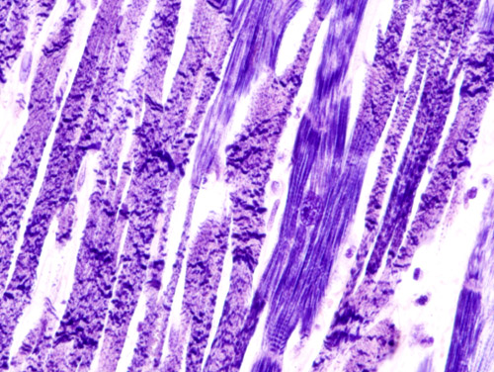
CONTRACTION BAND NECROSIS FROM STRESS
Notes:
Coagulative myocytolyis devoid of the white cell infiltration usually seen with acute myocardial infarction

Slide 45
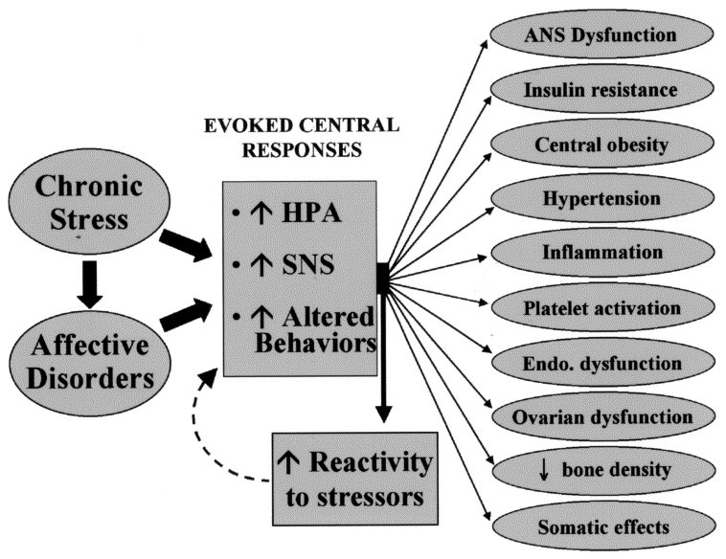
STRESS MECHANISMS THAT PROMOTE ATHEROSCLEROSIS
HPA=Hypothalamic-Pituitary Adrenal Axis
SNS=Sympathetic Nervous System
Notes:
. Pathophysiologic mechanisms by which chronic stress and affective disorders, such as depression, appear to promote atherosclerosis. These stressors activate the hypothalamic-pituitary-adrenal (HPA) axis and the sympathetic nervous system (SNS) and affect behaviors. Multiple adverse peripheral effects can ensue from this neuroendocrine, sympathetic, and behavioral activation, as shown. The neuroendocrine and neuroplastic changes emanating from these stressors can also induce a state of heightened physiologic responsivity to acute stress which may interact with chronic stressors to cause more adverse effects.

Slide 46
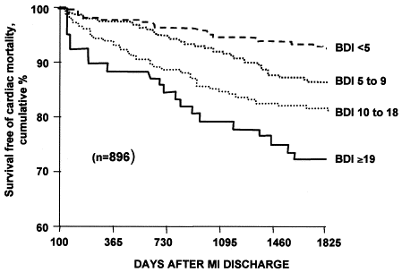
Magnitude Of Depressive Symptoms Post Myocardial Infarction And Frequency Of Cardiovascular Deaths
BDI=Beck Depression Inventory, ranging from no depressive symptoms (BDI <5) to moderate or severe (BDI ≥19). A Correlation can be seen even with mild symptoms (BDI 5-9)
Notes:
Post-myocardial infarction (MI) patients were recruited and assigned to one of four categories based on the Beck Depression Inventory (BDI), ranging from no depressive symptoms (BDI <5) to moderate to severe depressive symptoms (BDI ≥19). During the five-year follow-up period, a gradient relationship was observed between the magnitude of depressive symptoms and the frequency of deaths, with increased events occurring even in patients with mild depressive symptoms (BDI 5 to 9)

Slide 47
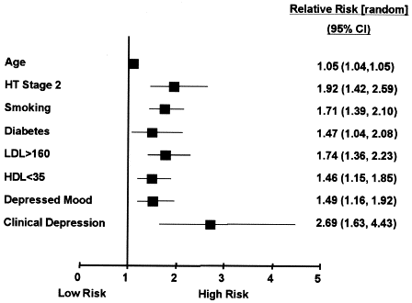
FRAMINGHAM RISK FACTOR RATIOS FOR MEN
Clinical Depression Greater Than Standard Risk Factors
Notes:
The risk ratios for traditional risk factors reported for men in the Framingham study (28). The risk ratios for depressive symptoms and clinical depression are from a recent meta-analysis by Rugulies et al. (3). The risk ratios for traditional risk factors are for death due to cardiac disease, myocardial infarction, coronary artery insufficiency, and development of angina. For depressive symptoms and clinical depression, the risk ratios are for death due to cardiac disease and myocardial infarction. CI = confidence interval; HT = hypertension; LDL = low-density lipoprotein; HDL = high-density lipoprotein.

Slide 48
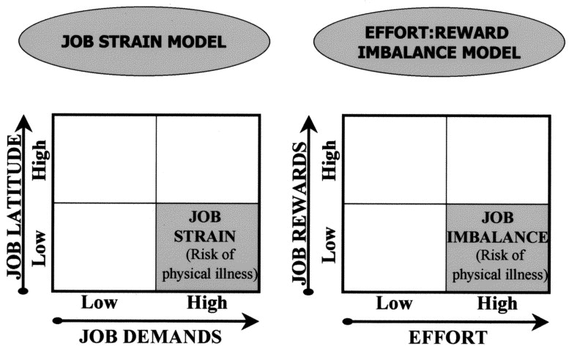
JOB STRESS AND CARDIOVASCULAR DISEASE
Notes:
Numerous surveys confirm that occupational stress is far and away the leading source of stress for adults. The Karasek-Theorell Demand/Control Model as well as Siegerist Effort/Reward Approach to measure job stress both confirm a higher incidence of illness and especially coronary and cardiovascular events in workers with high scores

Slide 49
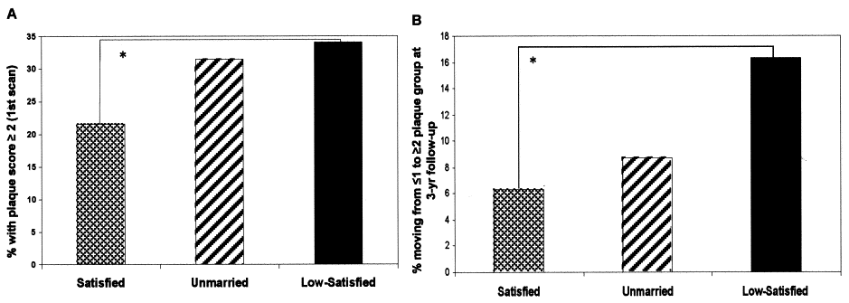
MARITAL DISCORD AND PLAQUE PROGRESSION
Postmenopausal females with satisfying marriages (left of each panel), unmarried (middle of each panel), and low-satisfying marriages (right of each panel). After 11 years of follow-up, the women in satisfied marriages had the lowest and the women in unsatisfying marriages had the highest percentage of significant plaque (left panel). Serial carotid ultrasonography performed after three years revealed that women in low-satisfying marriages also had the greatest progression of plaque during follow-up (right panel).
Notes:
. Postmenopausal females (n = 390) were divided into those in satisfying marriages (left of each panel), unmarried (middle of each panel), and in low-satisfying marriages (right of each panel). After 11 years of follow-up, the women in satisfied marriages had the lowest and the women in unsatisfying marriages had the highest percentage of significant plaque (left panel). Serial carotid ultrasonography was performed after three years in a subgroup of this patient population (n = 206) and revealed that women in low-satisfying marriages also had the greatest progression of plaque during follow-up (right panel). Reprinted with permission from Gallo et al. Psychosom Med 2003;65:952–62 (34). *Groups differ significantly at p < 0.05. Harvard Study of Adult Development is the longest and most comprehensive investigation of the aging process ever conducted. Since the 1930's, researchers have closely followed more than 800 men and women from adolescence to old age to seek clues about behaviors and activities that are associated with healthy longevity. Some of the findings surprised George Vaillant, the current director of this project and author of Aging Well. He had anticipated that "the longevity of your parents, the quality of your childhood and cholesterol levels would be very influential". They were not. Keeping mentally active and having lots of friends were much more important. A happy marriage or good long term relationship at age 50 was a leading indicator of being healthy at age 80 but a low cholesterol level had very little significance.

Slide 50
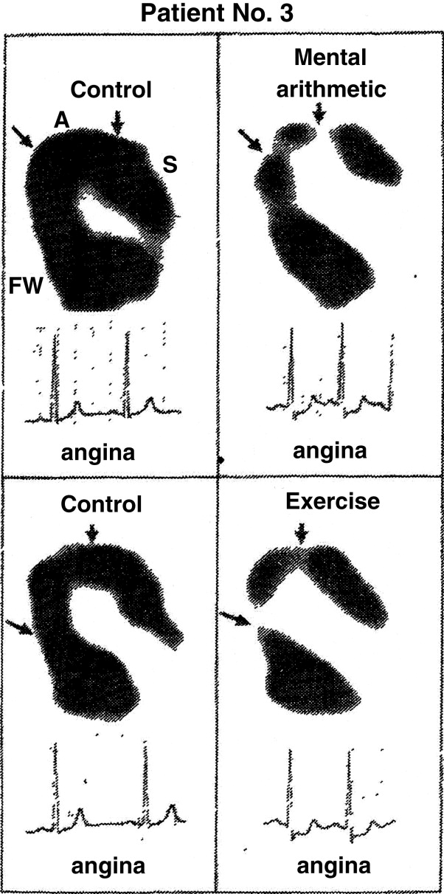
Effect of Mental Stress and Exercise on Regional Myocardial Uptake
Changes in regional myocardial uptake of rubidium-82 and in ECG in relation to chest pain before and after mental arithmetic or exercise. Control scans show homogeneous regional cation uptake. In the patient above there are defects in uptake (arrows) by the anterior wall with mental arithmetic and exercise, and these changes are accompanied by ST-segment depression and angina.
Notes:
Changes in regional myocardial uptake or rubidium-82 and in electrocardiogram in relation to chest pain before and after mental arithmetic or exercise. Control scans show homogeneous regional cation uptake. In the patient above there are defects in uptake (arrows) by the anterior wall with mental arithmetic and exercise, and these changes are accompanied by ST-segment depression and angina. A = anterior wall; FW = left ventricular free wall;
S = interventricular septum. Adapted and reprinted, with permission, from Deanfield et al. (9).

Slide 51
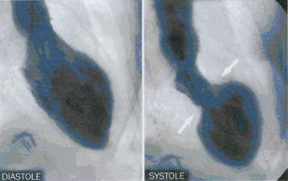
BROKEN HEART SYNDROME
Left ventricular angiogram in diastole (left) and systole (right) demonstrating wall motion abnormality characteristic of stress cardiomyopathy. At end systole, left ventricular chamber has a distinctive “short neck with round flask” configuration in which the apical) portion is hypokinetic whereas the remaining proximal portion is hypercontractile. (Sharp area of transition is shown by arrows) Also known as Takotsubo cardiomopathy.
Notes:
Figure 7. Angiogram in Stress Cardiomyopathy
Left ventricular angiogram in diastole (left) and systole (right) in right anterior oblique projection demonstrating wall motion abnormality characteristic of stress cardiomyopathy. At end systole, left ventricular chamber adopts distinctive “short neck with round flask” configuration in which distal (apical) portion is akinetic/hypokinetic whereas, in contrast, the remaining proximal (basal) segment is hypercontractile (sharp area of transition is shown by arrows). Reprinted, with permission, from Sharkey et al. (16).

Slide 52
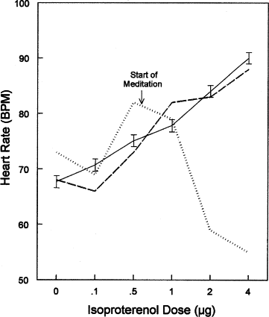
Meditation And HR Response to Isoproterenol Infusion
(Solid line) Mean ± standard error response to isoproterenol
(Dotted line) Patient’s response while meditating;
(Dashed line) Patient’s response when told not to meditate.
Notes:
Effect of Meditation on HR Response to Infused Isoproterenol
Effects of meditation on chronotropic responses to isoproterenol. (Solid line) Mean ± standard error response to isoproterenol in 93 women; (dotted line) patient’s response while meditating; (dashed line) patient’s response while instructed not to meditate. BPM = beats/min; HR = heart rate. Reprinted, with permission, from Dimsdale and Mills (39).

Slide 53
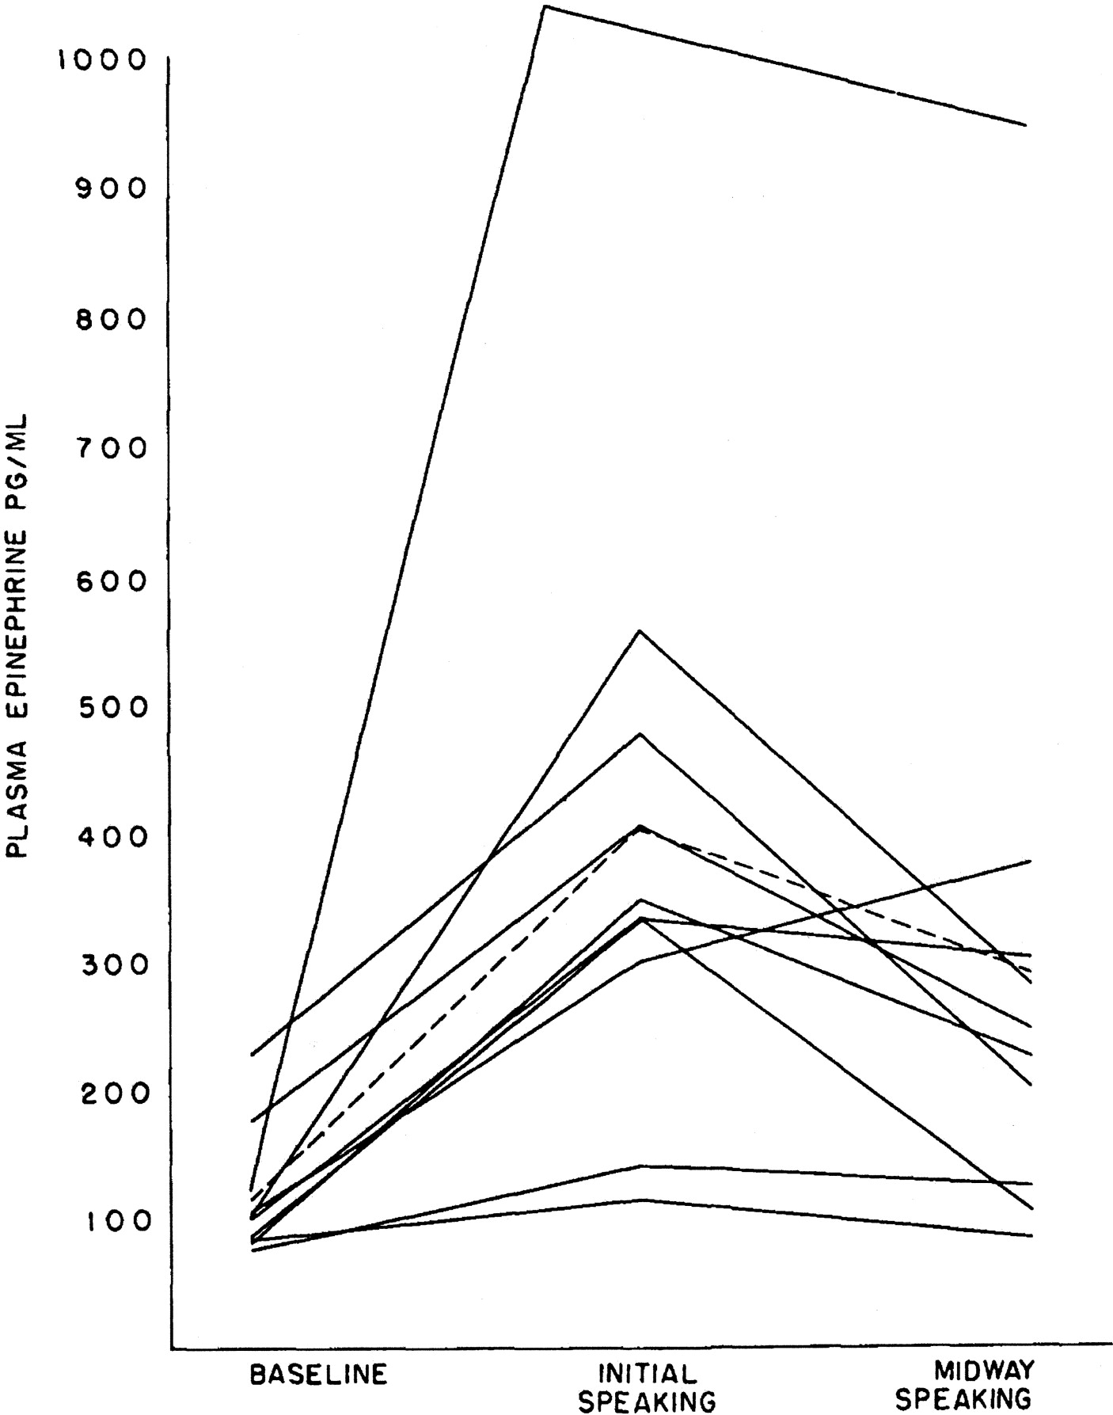
Public Speaking Stress And Plasma Epinephrine
Plasma epinephrine response to public speaking. Each line represents a single subject; the dotted line indicates the mean.
Notes:
Effect of Public Speaking on Plasma Epinephrine
Plasma epinephrine response to different activities. Each line represents a single subject; the dotted line indicates the mean. Reprinted, with permission, from Dimsdale and Moss (7).

Slide 54
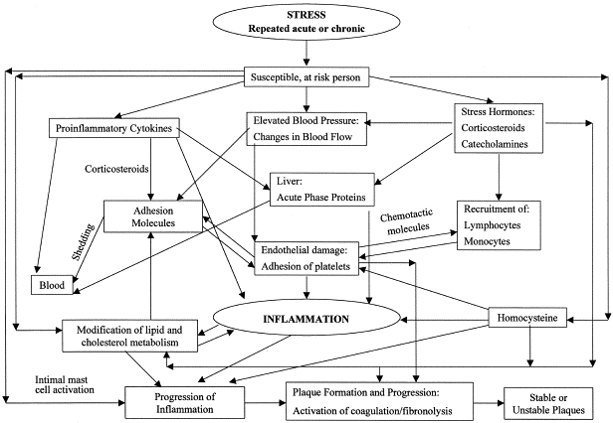
Notes:
Repeated episodes of acute stress or chronic stress can initiate and promote the atherosclerotic process. Stress induces cytokines, which, together with the major stress hormones corticosteroids and catecholamines, induce acute phase proteins (APPs) in the liver. Recurrent stress or chronic stress, with changes in blood flow and blood pressure, causes endothelial damage and adhesion of platelets. Cytokines, corticosteroids, and other factors induce adhesion molecules at sites of endothelial change, to which recruited monocytes and lymphocytes adhere and translocate to the arterial wall. Repeated or chronic stress, together with the acute phase reactants, promotes progression of the inflammatory response, with activation of macrophages and ensuing free radical formation, modification of lipids, foam cell formation, and activation of thrombotic events resulting in stable or unstable plaques. Elevation of homocysteine, which may also be induced by stress, would contribute to endothelial damage, platelet activation, thrombosis, the inflammatory process, smooth muscle cell hyperplasia, and proteolytic enzyme formation. Elevated homocysteine would augment lipid oxidation by oxidant stress and foam cell formation from LDL–homocysteine aggregates. Stress-induced activation of intimal mast cells by a neurogenic inflammatory process would also likely contribute to the inflammation.

Slide 55
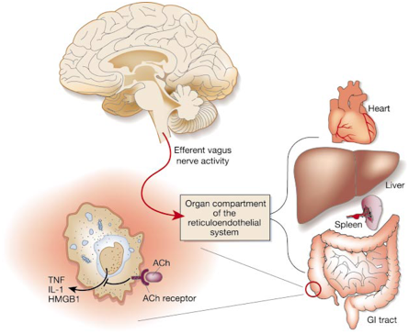
THE CHOLINERGIC ANTI-INFLAMMATORY PATHWAY
Efferent activity in the vagus nerve leads to acetylcholine (ACh) release in organs of the reticuloendothelial system, including the liver, heart, spleen and gastrointestinal tract. Acetylcholine interacts with nicotinic (ACh) receptors on tissue macrophages,which inhibit the release of TNF, IL-1, HMGB1 and other inflammatory cytokines.
Notes:
The cholinergic anti-inflammatory pathway. Efferent activity in the vagus nerve leads to acetylcholine (ACh) release in reticuloendothelial system organs, including the liver, heart, spleen and gastrointestinal tract. Acetylcholine interacts with nicotinic (ACh) receptors on tissue macrophages, which inhibit the release of TNF, IL-1, HMGB1 and other inflammatory cytokines

Slide 56
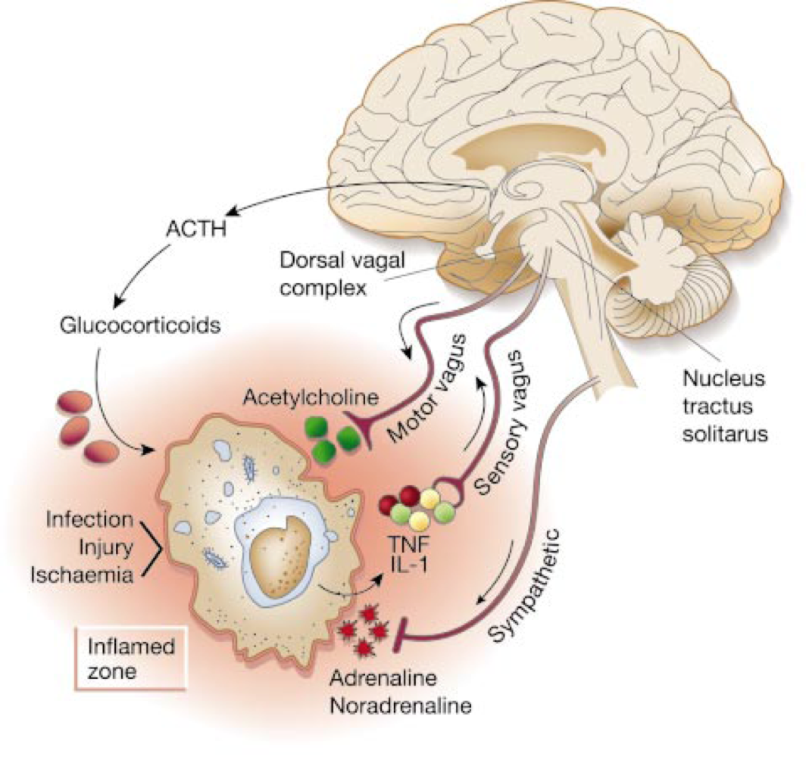
WIRING OF THE INFLAMMATORY REFLEX
Inflammatory products produced in damaged tissues activate afferent signals that are relayed to the nucleus tractus solitarius; subsequent activation of vagus efferent activity inhibits cytokine synthesis through the cholinergic anti-inflammatory pathway (‘the inflammatory reflex’). Information can also be relayed to the hypothalamus and the dorsal vagal complex to stimulate the release of ACTH, thereby activating the humoral anti-inflammatory pathway. Activation of the sympathetic outflow by flight-or-fight responses or pain, or through direct signaling, can increase local concentrations of adrenaline and noradrenaline, which can further suppress inflammation.
Notes:
Wiring of the inflammatory reflex. Inflammatory products produced in damaged tissues activate afferent signals that are relayed to the nucleus tractus solitarius; subsequent activation of vagus efferent activity inhibits cytokine synthesis through the cholinergic anti-inflammatory pathway (‘the inflammatory reflex’). Information can also be relayed to the hypothalamus and the dorsal vagal complex to stimulate the release of ACTH, thereby activating the humoral anti-inflammatory pathway. Activation of the sympathetic outflow by flight-or-fight responses or pain, or through direct signaIIng, can increase local concentrations of adrenaline and noradrenaline, which can further suppress inflammation.

Slide 57
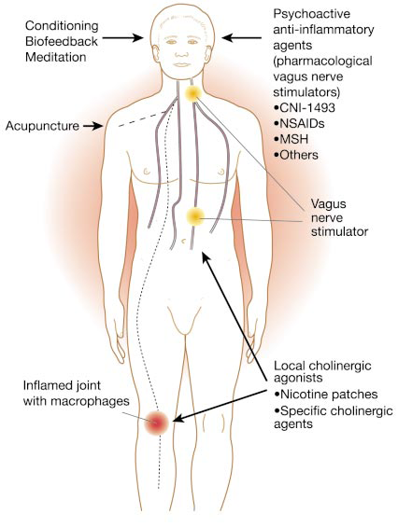
Targeting therapies to the cholinergic anti-inflammatory pathway. The physiological basis of the cholinergic anti-inflammatory pathway could guide the development of therapies based on either modulating the activity of the vagus nerve or targeting specific components of the pathway. biofeedback, conditioning, meditation, hypnosis or acupuncture could be potentially used to modulate vagus output, ‘psychoactive’ drugs could be tailor-made to increase vagus output (‘pharmacological vagus nerve stimulators’; non-steroidal anti-inflammatory drugs, and other agents could be used to target macrophage cholinergic receptors in the periphery. Unbroken lines represent known vagus nerve pathways; dotted lines are hypothetical

Slide 58
DOES STRESS REDUCTION WORK?
In a study of 200 high risk patients, half were randomly assigned to two groups. Both received standard drug therapy to lower cholesterol and treat hypertension and education about healthy diets and lifestyles. One group also received instruction in transcendental meditation, which the practices faithfully for 15-20 minutes/day. A 5 to 9 year follow-up revealed that the meditators had almost half as many heart attacks, stroke, and deaths from all causes, compared to the no meditation controls. The meditating group also had less disease and a greater reduction in blood pressure.
Transcendental meditation was also shown to reduce complications in African American men and women hospitalized for Class ll and Class III congestive failure. Participants were randomly assigned to a transcendental meditation or health education group in addition to their usual medical care. They were evaluated at baseline, and three and six months after the intervention to determine effects of the intervention on heart function (six-minute walk test) as well as quality of life, depression, and rehospitalizations. Compared to controls, the meditation group had less depression, fewer rehospitalizations and better quality of life score and were significantly improved on the six-minute walk test after both three and six months.

Slide 59
DOES STRESS REDUCTION WORK?
In another study of African American men and women at increased risk for cardiovascular disease because of hypertension, half were assigned to a transcendental meditation program or a health education control group. Carotid intima-media thickness (IMT), which reflects the degree of carotid atherosclerosis, was measured by ultrasound. After seven months, a repeat IMT revealed a decrease in thickness in meditators in contrast to an increase in controls. IMT is widely used as a surrogate for coronary atherosclerosis and to predict heart attack and stroke and the degree of reduction indicated an approximate 11% decrease in risk for heart attack and 7.7% to 15% reduction in risk of stroke in the meditation group. These benefits are comparable to those achieved by statins and intensive lifestyle modification programs. There was no significant difference in baseline characteristics, intervention, duration or attrition between the two groups.

Slide 60
DOES STRESS REDUCTION WORK?
Numerous studies published in peer-reviewed journals confirm the benefits of meditation in age groups ranging from adolescents and college students to the elderly with varied degrees of hypertension. A 2008 meta-analysis of articles revealed a reduction of systolic and diastolic blood pressure by 6.3 and 4 mm Hg, respectively, which are clinically significant.
With respect to mechanisms of action, pituitary-adrenal cortex axis function and adrenal medullary sympathetic activity were evaluated in experienced Sidhi transcendental meditators. Blood samples were taken at hourly intervals from 09:00 to 21:00h and the subjects meditated for one hour between 12:00 and 13:00. Cortisol and ACTH levels were measured by radioimmunoassay methods and catecholamine concentrations were determined by high performance liquid chromatography. Catecholamine values declined after the period of meditation, and reached the lowest levels at 14:00. This could explain in part their benefits in hypertension. Although no significant differences in pituitary- adrenal cortical function were demonstrated, subjects with longer experience in the practice of this technique had lower mean values of ACTH and cortisol compared to those with less experience.
Notes:
Em wave

Slide 61
IS THERE PROOF THAT STRESS CAUSES CHD?
There is at least very strong evidence based on a study that will appear in the next month's issue of JCEM. Dutch researchers measured 24 hour urine cortisol levels in almost 900 senior citizens participating in a prospective cohort study. Over the next three years, there were 181 deaths, Researchers found a clear correlation between elevated cortisol and deaths from heart disease but not other causes. One third of the subjects with the highest urinary cortisols had a five-fold increased risk of death due to coronary heart disease.
A team of Canadian and Israeli investigators came to a similar conclusion in the current issue of Stress using an enzyme immunoassay technique that measures cortisol concentrations in hair, which grows about 1 cm/month. A 6 cm. hair sample shows cortisol levels over the past 6 months, and in this study, researchers collected 3 cm. long samples from 56 men admitted for acute myocardial infarction and controls admitted for other diagnoses. Higher hair cortisol levels corresponding to the previous three months were found in the heart attack patients compared to the control group. The prevalence of diabetes, hypertension, smoking and family history of coronary artery disease did not differ significantly between the two groups, although the heart attack group had higher average cholesterols. After accounting for the known risk factors, hair cortisol content emerged as the strongest predictor of heart attack.

Slide 62
WHY DOES THE LIPID THEORY PERSIST?
Cholesterol Cartel Control Over The FDA And Other Regulatory Bodies, Prestigious Associations And Physicians , Medical Academia And The Media
Deceptive Television And Magazine Advertising
Confusing Association With Causation And Labeling Risk Markers As Risk Factors
Relative Risk And Other Statistical Manipulations
Ruthless Recrimination For Any Opposition And Personal Persecution Of Critics

Slide 63
THE CHOLESTEROL CARTEL
AN EXTREMELY POWERFUL & WEALTHY COALITION OF:
Makers of non prescription supplements (phytosterols to
lower cholesterol, chitosan to bind fats and fat “burners”.
Manufacturers of testing equipment to measure cholesterol, LDL
Pharmaceutical companies that provide statins and other drugs to lower cholesterol or reduce the absorption of fats.
Manufacturers of low fat foods or substitutes (soy, margarine).
and other blood lipids.
Tremendous influence if not control over regulatory agencies (FDA, Congress), medical schools (research grants, CME) the media (peer reviewed journals, print and especially direct to consumer TV ads), organizations (AMA, AHA0 and physician prescribing habits (drug reps, illegal kickbacks, paid vacations).
Notes:
63
Spend over $10,000/physician each year on direct marketing to physicians over $15 billion/year 90.000 drug reps.

Slide 64
Relative vs. Absolute Risk vs. NNT
Your doctor tells you that there is a new statin drug with no side effects and if you take it every day for the next five years it will significantly "reduce your risk" of having a heart attack. Would you take the drug based on the following?
1. Over five years, patients on this drug had 34% fewer heart
attacks than controls on a placebo. Relative risk reduction 34%
2. Over five years, 2.7% of patients on the drug had a heart attack
compared to 4.1% taking a placebo. Absolute risk reduction 1.4%
3. If this drug is taken by seventy-one people every day for five years
it will prevent one person from having a heart attack, but it is not
known if that person will be you. - NNT (Number needed to treat)
THESE FIGURES ARE ALL FROM THE SAME STUDY
"If you can't convince them, confuse them"
Harry S. Truman
Notes:
Statistics are like expert witnesses, they will testify for either side.
6 major statin trials (EXCEL, 4S, WOSCOPS, CARE, AFCAPS, LIPID), the reduction of cardiovascular mortality ranged from -19% to -41% when expressed as relative risk reduction, but from -0.12% to -3.5% when expressed as absolute risk reduction. This fudging of figures is reminiscent of Disraeli and later Mark Twain's claim that There are lies, damn lies, and statistics.
Statistics are a highly logical and precise method for stating a half-truth inaccurately
first law - If the statistics done’t support your theory, you need more statistics
2nd law – given enough statistics you can prove anything.

Slide 65
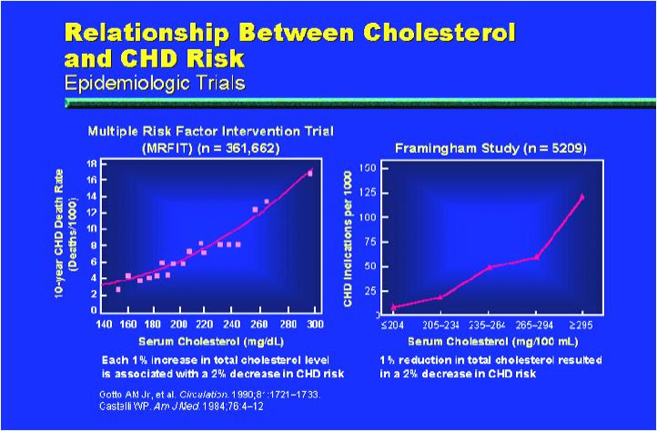
ASSOCIATION NEVER PROVES CAUSATION
RELATIVE RISK REDUCTION PROJECTIONS
Notes:
Cholesterol is a risk marker, not a risk factor that causes heart disease, like homocysteine. Hundreds of risk factors that are just statistical association

Slide 66
ASSOCIATION NEVER PROVES CAUSATION
The Japanese eat very little fat and suffer fewer heart attacks than the British or Americans.
The French eat a lot of saturated fat and also suffer fewer heart attacks than the British or Americans.
The Japanese drink very little red wine and suffer fewer heart attacks than the British or Americans.
The Italians and French drink excessive amounts of red wine and also suffer fewer heart attacks than the British or Americans.
The Germans consume huge quantities of beer, eat lots of sausages and fats and suffer fewer heart attacks than the British or Americans.
EAT AND DRINK WHATEVER YOU WANT! SPEAKING ENGLISH IS APPARENTLY WHAT CAUSES HEART ATTACKS
Notes:
Just because there are usually fire trucks and firemen at the scene of a fire doesn't mean they caused it. There is a difference between coherence and correlation. Coherence Is The Coincidence Of Changes Occurring To Two Parameters. Correlation Is A Mathematical Relationship Between Two Parameters There is good coherence between children returning to school at the end of the summer vacation and leaves falling off trees since these two parameters exhibit these changes each year. But there is poor correlation between children returning to school at the end of their vacation and leaves falling off trees. The number of returning children is not mathematically related to the number of falling leaves. And there is no causal relationship between children returning to school at the end of their summer break and leaves falling off trees. As someone also wisely said, Statistics are a highly logical and precise method for saying a half-truth inaccurately

Slide 67
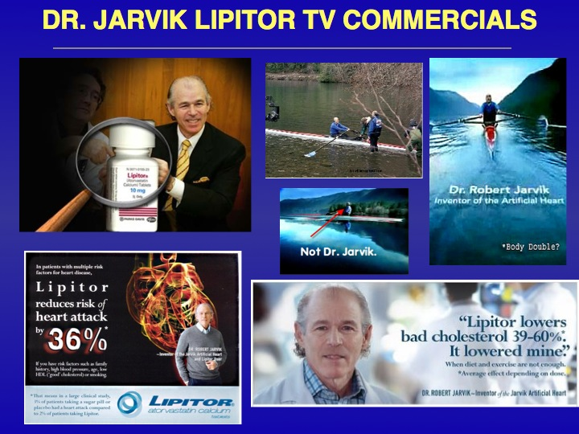
Notes:
Dr Jarvik introduces himself as "Doctor," attests to the years has spent "studying the heart," and developing the Jarvik artificial heart. He praises the value of Lipitor, which he takes himself, and is shown jogging, and apparently rowing a racing scull in a highly skilled fashion. The facts are that Dr Jarvik is not a cardiologist, is not even licensed to practice medicine, has never treated a patient and did not take Lipitor until he was hired for the ad for $1.5 million. He does not know how to row, and the artificial heart that bears his name was invented by someone else and never worked. The shots demonstrating his sculling expertise were of an athletic, late middle-aged accomplished rower who resembled him. Viewers were impressed with his stunt double's ability to turn the blades perfectly to achieve minimum drag between strokes. The close up frames that actually showed Dr. Jarvik were taken while he was in a rowing apparatus on a platform to conceal that it was on dry land with the lake in the background. Few paid any attention to the asterisk after the claim that Lipitor resulted in a "36% reduction in heart attacks*". It pointed to a statement in mice type at the bottom of the screen explaining that there were 2 heart attacks out of 100 patients on Lipitor, compared to 3 heart attacks for controls taking a placebo. However, this 1% difference was only for those with "multiple risk factors for heart disease" who took Lipitor daily for over a decade. How many people would take Lipitor if they knew that its likelihood of preventing a heart attack was one in 100 if they took it for over ten years? And this is only for those at high risk. The difference, according to the study, is that for every 100 people who take Lipitor, only one additional person will be spared a heart attack compared to those who do nothing. TV drug ads to consumers only in the U.S. since 1997 for educational purposes. Congressional inquiry revealed Jarvik was paid $1.5 million plus additional payments to his son and wife
67

Slide 68
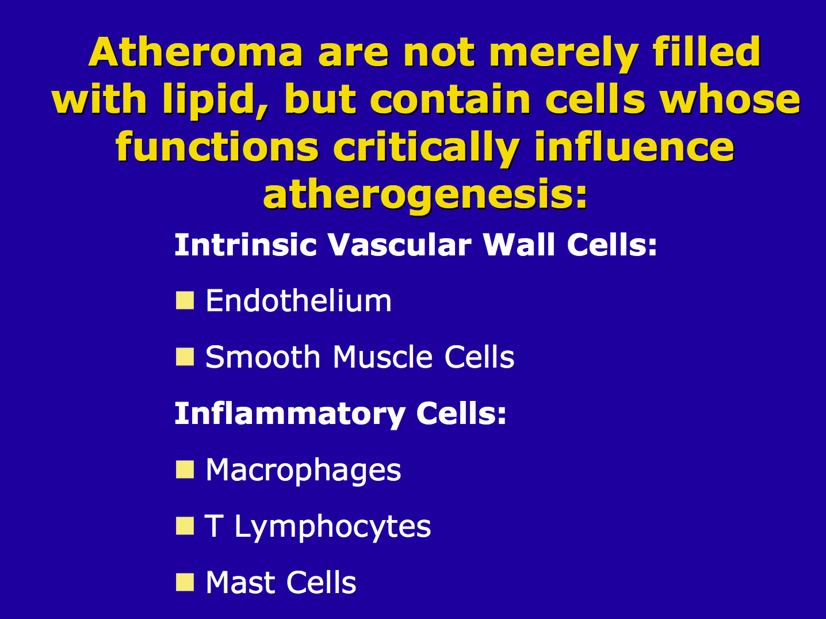
ATHEROMA ARE NOT MERELY LIPID DEPOSITS
Notes:
Drug companies ignore the fact that atheroma contain much more than cholesterol THEY CONTAIN CELLS THAT PLAY A CRITICAL ROLE IN ATHEROGENESIS
68

Slide 69
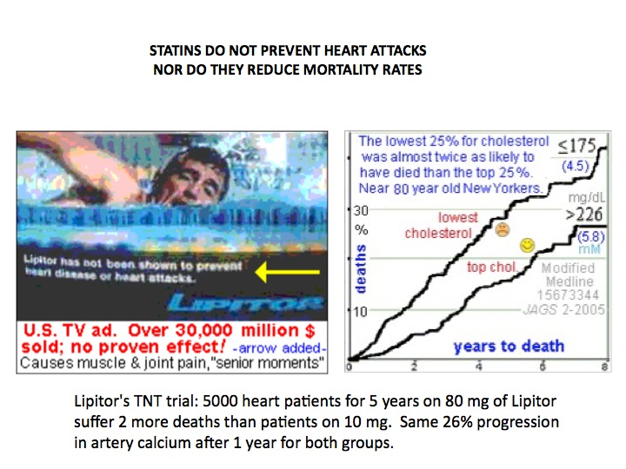
Notes:
69
the death rate for those in the highest 20%!
SAME emphasis on relative risk for STATINS. Never see an add that says reduces heart attacks, if you look at the fine print on the bottom in mice type Lipitor has NOT been shown to prevent heart disease or heart attacks.” ”Crestor has NOT been shown to prevent heart disease or heart attacks
In elderly individuals, those with the lowerst cholesterols were almost twice as likely to die as those with the highest.
Heart Failure Patients - those with cholesterol levels in the lowest 20% had double
In 65,000 men in which there were 2700 deaths, those with the lowest cholesterol [below 187 (4.8mM)] had the most deaths!
The American College of Cardiology in 2004: "... there is no evidence for a total mortality benefit in women treated with statins for dyslipidemia. Women had 3 more deaths on Zocor and 2 more heart attacks on Lipitor in large studies (Simvastatin 4S, ASCOT).
STATINS DO NOT PREVENT HEART ATTACKS OR REDUCE DEATHS

Slide 70
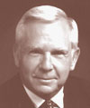
CHOLESTEROL CARTEL PERSECUTION
George Mann
Professor of Medicine at Vanderbilt and
renowned nutritionist. Early Framingham
researcher whose study finding no evidence that fat intake or cholesterol was not related to heart attacks or mortality was never published.
In a 1977 New England Journal of Medicine review entitled “Diet-Heart: End of an Era,” he wrote that “the dietary dogma was a money-maker for segments of the food industry, a fund-raiser for the Heart Association, and busy work for thousands of fat chemists”, and that “to be a dissenter was to be unfunded because the peer-review system rewards conformity and excludes criticism.” He cited the lack of relationship between diet and cholesterol, the lack of correlation between trends in fat consumption and death rates in the US and the disappointing outcome of the cholesterol lowering trials.
Notes:
70
70
In 1991, Mann wanted to bring the issue before the public by organizing a conference in Washington, DC. In his invitation to prominent speakers he wrote. "Hundreds of millions of tax dollars are wasted by the bureaucracy and the self-interested Heart Association," Segments of the food industry play the game for profits. Research on the true causes and prevention is stifled by denying funding to the 'unbelievers'. This meeting will review the data and expose the rascals." When the cholesterol cartel found out they sent out false notices to everyone that the event would be canceled, participants backed out when they learned their funding would be cut off and the Foundation that offered to back it reneged. Eventually financed it himself.

Slide 71
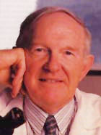

CHOLESTEROL CARTEL PERSECUTION
KILMER McCULLY
Harvard Professor whose research suggested that high homocysteine might be more important than cholesterol and could be corrected with B vitamins.
Funding for research disappeared leading to the loss of his laboratory at Massachusetts General Hospital. The hospital Director told him to leave and "never to come back" and his Harvard affiliation and tenure was also terminated in 1978. When subsequently interviewed about his research on a TV program, he promptly received a phone call from the Public Affairs Director of the hospital who told him to "shut up" and that "they didn't want the names of Harvard and Massachusetts General Hospital to be associated with my theories."
Notes:
71
71
Although obviously well qualified for many positions that were being offered and despite the fact that he did well on numerous interviews he was unable to find employment for two years. When he and others who had recommended him made appropriate follow-up inquiries they ran into a stone wall of silence. However, repeated rumors of "poison phone calls" from Harvard began to surface and it was only after a leading Boston attorney threatened a lawsuit that things suddenly changed and he was able to resume his research at the Veterans Administration Hospital in Providence, Rhode Island. For those of us who know Kilmer to be a reserved, conservative and very cautious and careful researcher, this was an incredible saga of malicious persecution. Since then, the contribution of homocysteine to heart attacks, stroke, and accelerated atherosclerosis has been repeatedly confirmed, as well as links to other disorders, including periodontal disease and cirrhosis of the liver. Harvard has welcomed him back with open arms and even Kilmer's former critics now acknowledge he was correct. He has been the recipient of numerous awards and honors, and many feel he should be considered for a Nobel Prize.
Another good friend Uffe Ravnskov has had a similar experience.

Slide 72


CHOLESTEROL CARTEL PERSECUTION
UFFE RAVNSKOV
Received his M.D. from the University of Copenhagen in 1961 and a Ph.D. in Clinical Chemistry and Nephrology in 1973 from the University of Lund where he served as Professor of Nephrology before leaving to devote his time to private investigations.
This research culminated in the 1997 publication of The Cholesterol Myths: Exposing the Fallacy that Saturated Fat and Cholesterol Cause Heart Disease. This provided a comprehensive and objective analysis of the literature dealing with the role of dietary fat and elevated blood cholesterol on health and coronary heart disease that has never been refuted.
Notes:
72
72
It was painstakingly referenced with numerous citations proving that a high fat diet did not cause either elevated cholesterol or coronary disease. In addition, it showed that high cholesterol actually confers protective benefits, especially in the elderly. Ravnskov's conclusions were so contrary to the prevailing dogma that he was severely berated by the bureaucracy and his book was actually burned on a Finnish TV program by cholesterol enthusiasts. More recently he was defamed on a Dutch TV program. Critics could only resort to such personal attacks because they were unable to refute any of his claims or conclusion and refused to debate him on TV. Since then he has written several other books providing updated confirmation of his views by others.

Slide 73
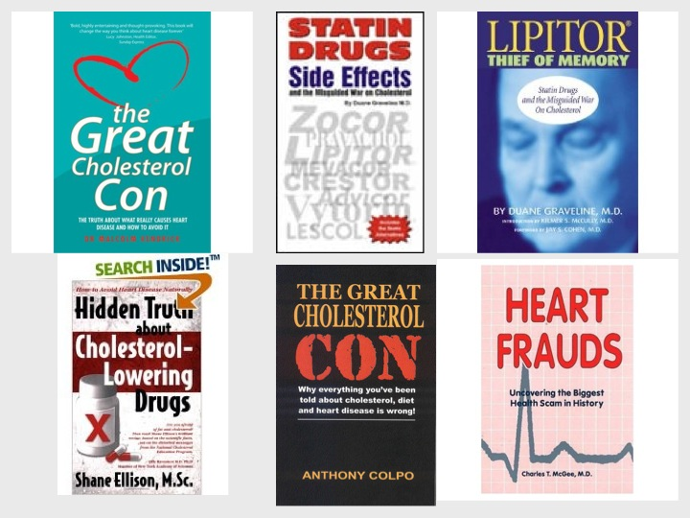
Notes:
. Numerous books have been written because it’s hard to get anything published in peer reviewed journals questioning the importance of cholesterol or dietary fat as the cause of coronary disease due to the power of the cholesterol cartel.

Slide 74
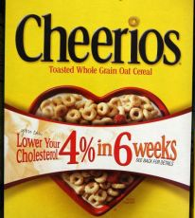
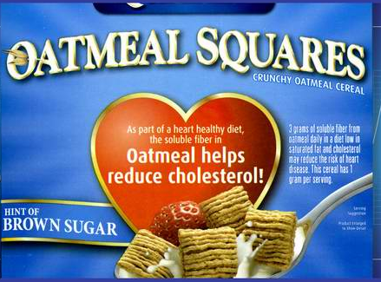

Notes:
Ridiculous ads touting heart health that are endorsed by the American Heart Association

Slide 75
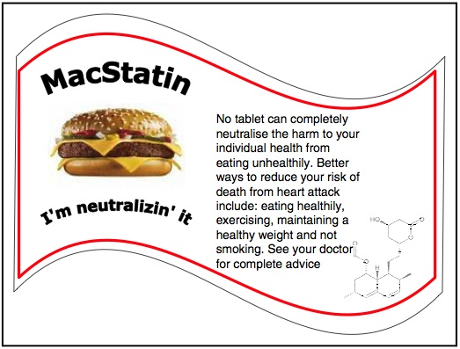
Notes:
Some enthusiasts want statins to be added to drinking water, like fluoride and more recently, to make them available free next to salt, pepper, ketchup and mustard at fast food chains

Slide 76

Notes:
Allopathy refers to the treatment of disease by conventional means, i.e., with drugs having opposite effects to the symptoms. Often contrasted with homeopathy coined by Samuel Hahnemann, the founder of homeopathy.[1] It meant "other than the disease" and it was intended, among other things, to point out how regular doctors used methods that Hahnemann felt had nothing to do with the disharmony produced by disease, merely addressing symptoms, which, in Hahnemann's view, meant that these methods were harmful to the patients.[1]
Originally intended as a characterization of standard medicine in the early 19th century, these terms were rejected by mainstream physicians and quickly acquired negative overtones

Slide 77
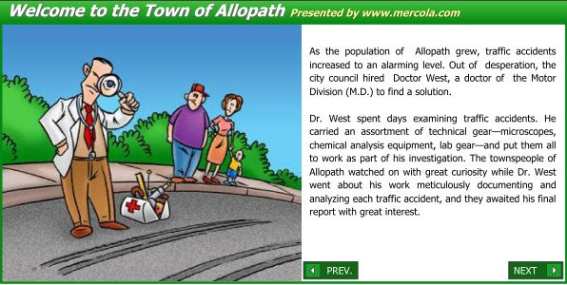

Slide 78
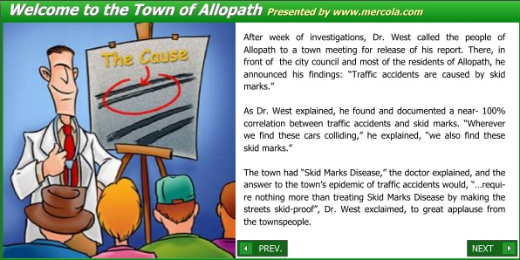

Slide 79


Slide 80


Slide 81


Slide 82


Slide 83
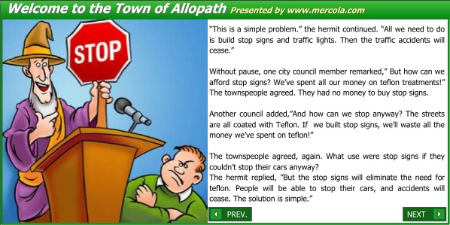

Slide 84


Slide 85


Slide 86


Slide 87
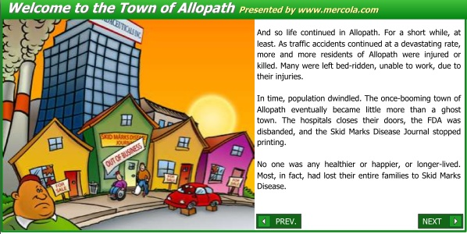

Slide 88


Slide 89
It Is Impossible for Anyone to Begin to Learn What He Thinks He Already Knows.
~Epictetus ~
(Greek born Roman Philosopher 55 AD - 135 AD)
What gets us into trouble is not what we don't know, It's what we know for sure, that just aint so.
~Mark Twain~
It is difficult to get a man to understand something when his salary depends upon his not understanding it.
~Upton Sinclair~
Notes:
Here are some quotes from others that are relevant and instructive

Slide 90
Whenever a theory appears to you as the only possible one, take this as a sign that you have neither understood the theory nor the problem which it was intended to solve.
No rational argument will have a rational effect on a man who does not want to adopt a rational attitude.
~Sir Karl Popper ~
Skepticism is the chastity of the mind. Do not
surrender it to the first comer or too readily.
~ George Santayana ~
Science is organized common sense where many a beautiful theory was killed by an ugly fact.
~ Thomas Henry Huxley ~

Slide 91
For every complicated problem there is a solution that is simple, direct, understandable and wrong.
~ H. L. Mencken
All truth passes through three stages. First, it is ridiculed, Second it is violently opposed, and Third, it is accepted as self-evident. ~ Arthur Schopenhauer ~
A new scientific truth does not triumph by convincing its opponents and making them see the light, but rather because its opponents eventually die and a new generation grows up that is familiar with it.
~ Max Planck
Notes:
91
I doubt very much that I will see the demise of the lipid hypothesis in my lifetime, but I am confident that the truth will out as more competent causes of coronary heart disease are elucidated, some of which were suggested in my previous presentation and will likrely be expanded on by Dr. McCully. Thank you for your kind attention..
Thank you for your kind attention and for not stoning me (as the Finns wanted to do to Uffe) for expressing these opinions, I suspect that many of you will understandably consider them heretical, but will also find them difficult to refute.

